Slide 1
실시간 운영체제
MicroC/OS-II 분석
디오이즈

Slide 2
Before we get started...
Typical Foreground/Background system
process1
process4
process2
process3

Slide 3
Before we get started...
Typical Foreground/Background system
BYTE intFlag1,intFlag2,intFlag3,intFlag4;
#pragma interrupt ExtInt1(void)
{
Process external interrupt 1;
intFlag1 = ON;
}
.
.
#pragma interrupt ExtInt4(void)
{
Process external interrupt 4;
intFlag4 = ON;
}
void main(void)
{
시스템 초기화;
인터럽트 활성화;
intFlag1 = intFlag2 = OFF;
intFlag3 = intFlag4 = OFF;
for(;;)
{
if(intFlag1==ON)
{
process1();
intFlag1 = OFF;
}
if(intFlag2==ON)
{
process2();
intFlag2 = OFF;
}
………
if(intFlag4==ON)
{
process4();
intFlag4 = OFF;
}
}
}

Slide 4
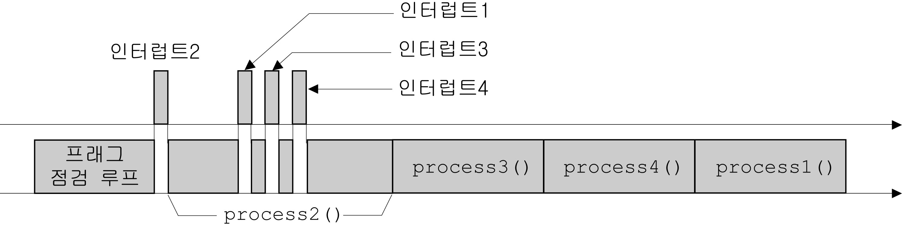
Before we get started...
Time characteristics (responsiveness)
of typical F/B systems

Slide 5
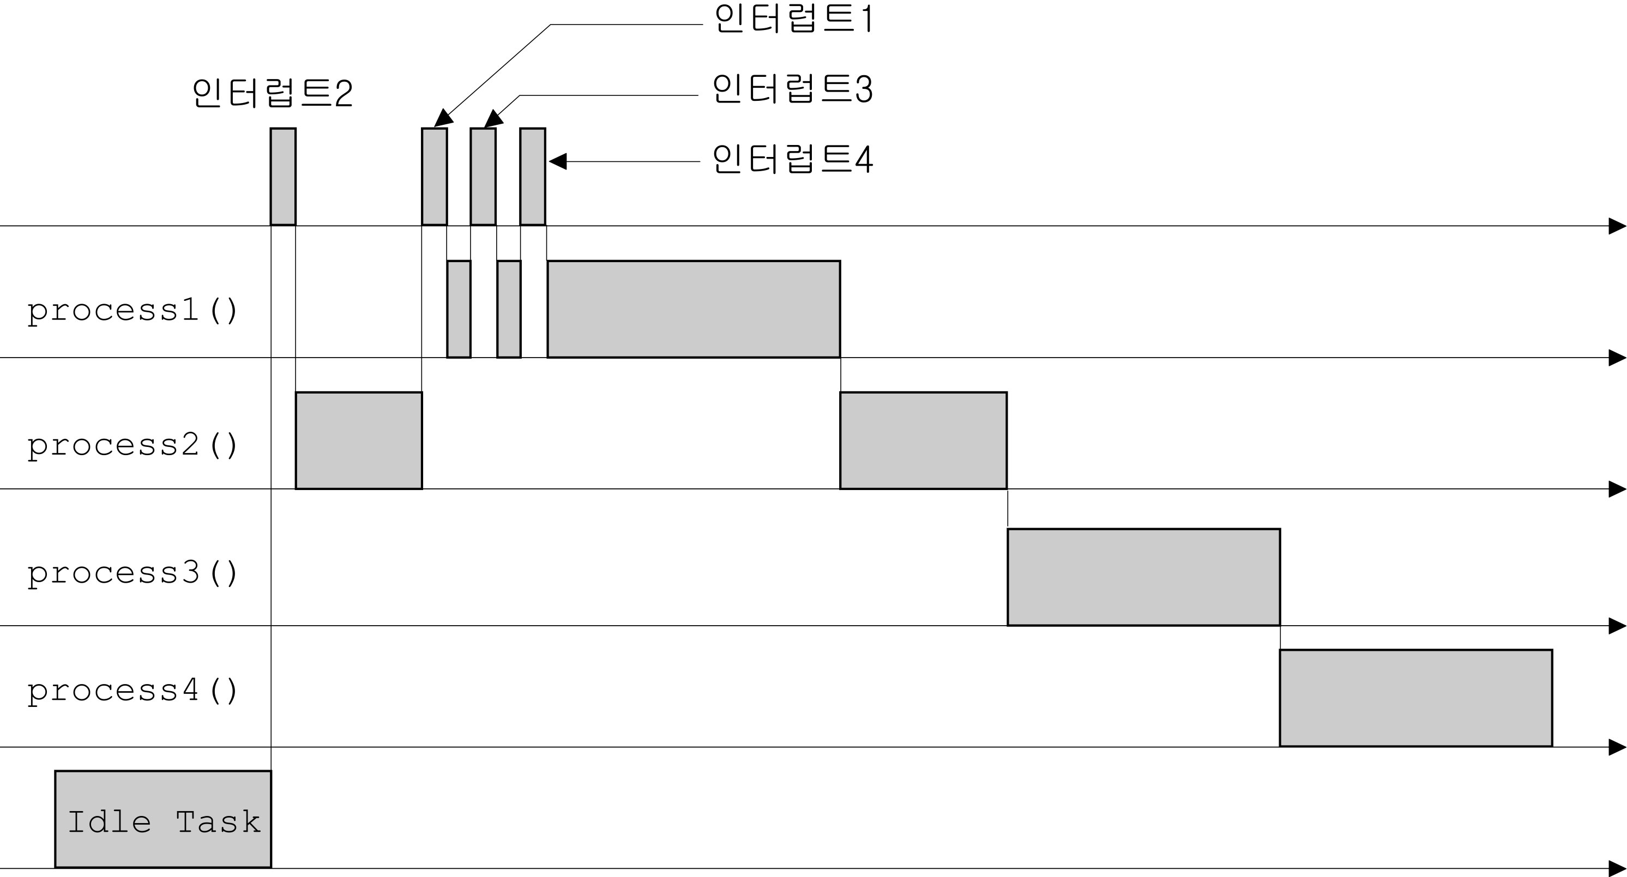
Before we get started...
Typical multitasking systems

Slide 6
Before we get started...
Inherent problems of Foreground/Background Systems
  Responsiveness
    Response time is always subject to be changed when the software is modified.
  Software modularization
    Maintenance
    Complicated Design
  Hard to implement multitasking

Slide 7
An Overview of RTOS
What is?
  Manages time scheduling of each tasks.
  guarantees a certain capability within a specified time constraint (responsiveness)
Why use?
  Applications are becoming more complex.
    Responsiveness must be guaranteed.
  Hardware resources are getting cheaper.
  Easy to design and maintain application software.
    Some backgrounds of RTOS are needed.
    Parallel Multitasking is possible.

Slide 8
About MicroC/OS-II
What is?
  Highly portable, ROMable, very scalable, preemptive real-time, multitasking kernel (RTOS). µC/OS-II can manage up to 63 application tasks and provides essential kernel services.
Reliability
  A validation suite developed for µC/OS-II provides all of the documentation necessary to prove that µC/OS-II is suitable for use in safety critical systems common to aviation and medical products. The validation suite, is available through Validated Software. A follow-on package will bring µC/OS-II and the suite up to full DO-178B level A certifiability.

Slide 9
Critical section of code
Also called ‘critical region’ -Atomic
When executing this region, interrupts
never occur(disabled).
Execution time must be as short as possible.
.
.
Load Rx, [g_TotalCnt]
Inc Rx
Store [g_TotalCnt], Rx
.
.
.
.
g_TotalCnt = g_TotalCnt +1;
.
.

Slide 10
Resources
A resource is any entity used by a task. A resource can thus be an I/O device, such as a printer, a keyboard, a display, a variable, a structure, or an array.
Shared resources
A shared resource is a resource that can be used by more than one task. Each task should gain exclusive access to the shared resource to prevent data corruption.

Slide 11
Multitasking
Multitasking is the process of scheduling and switching the central processing unit (CPU) between several tasks.
Multitasking maximizes the use of the CPU and also provides for modular construction of applications.
One of the most important aspects of multitasking is that it allows the application programmer to manage complexity inherent in real-time applications.
Application programs are typically easier to design and maintain if multitasking is used.

Slide 12
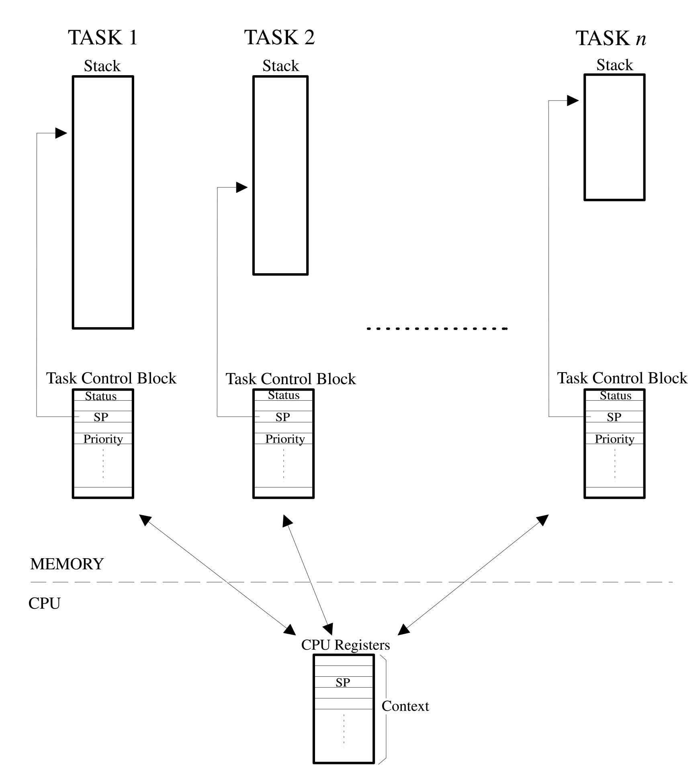
Task (Thread)

Slide 13
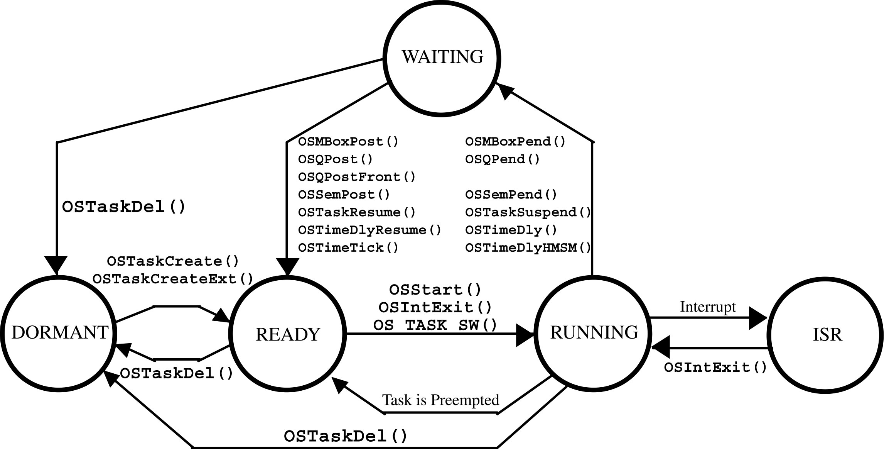
Task States

Slide 14
Context Switches (or Task Switches)
When a multitasking kernel decides to run a different task, it saves the current task’s context (CPU registers) in the current task’s context storage area — its stack.
After this operation is performed, the new task’s context is restored from its storage area and then resumes execution of the new task’s code.
This process is called a context switch or a task switch. Context switching adds overhead to the application. The more registers a CPU has, the higher the overhead.

Slide 15
Kernels
The kernel is the part of a multitasking system responsible for management of tasks and communication between tasks.
The fundamental service provided by the kernel is context switching.
In a well-designed application, a kernel uses between 2 and 5% of CPU time.
Because a kernel is software that gets added to your application, it requires extra ROM (code space) and additional RAM (data space) for the kernel data structures, and each task requires its own stack space, which eats up RAM quickly.

Slide 16
Schedulers
The scheduler is the part of the kernel responsible for determining which task runs next.
Most real-time kernels are priority based. Each task is assigned a priority based on its importance.
In a priority-based kernel, control of the CPU is always given to the highest priority task ready to run.

Slide 17
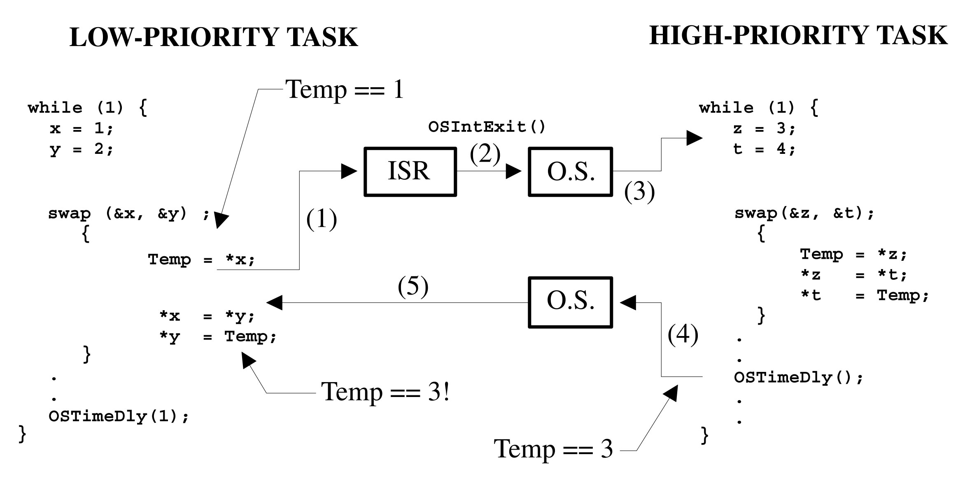
Reentrancy

Slide 18
Task Priorities
A priority is assigned to each task.
The more important the task, the higher the priority given to it.
With most kernels, you are generally responsible for deciding what priority each task gets.

Slide 19
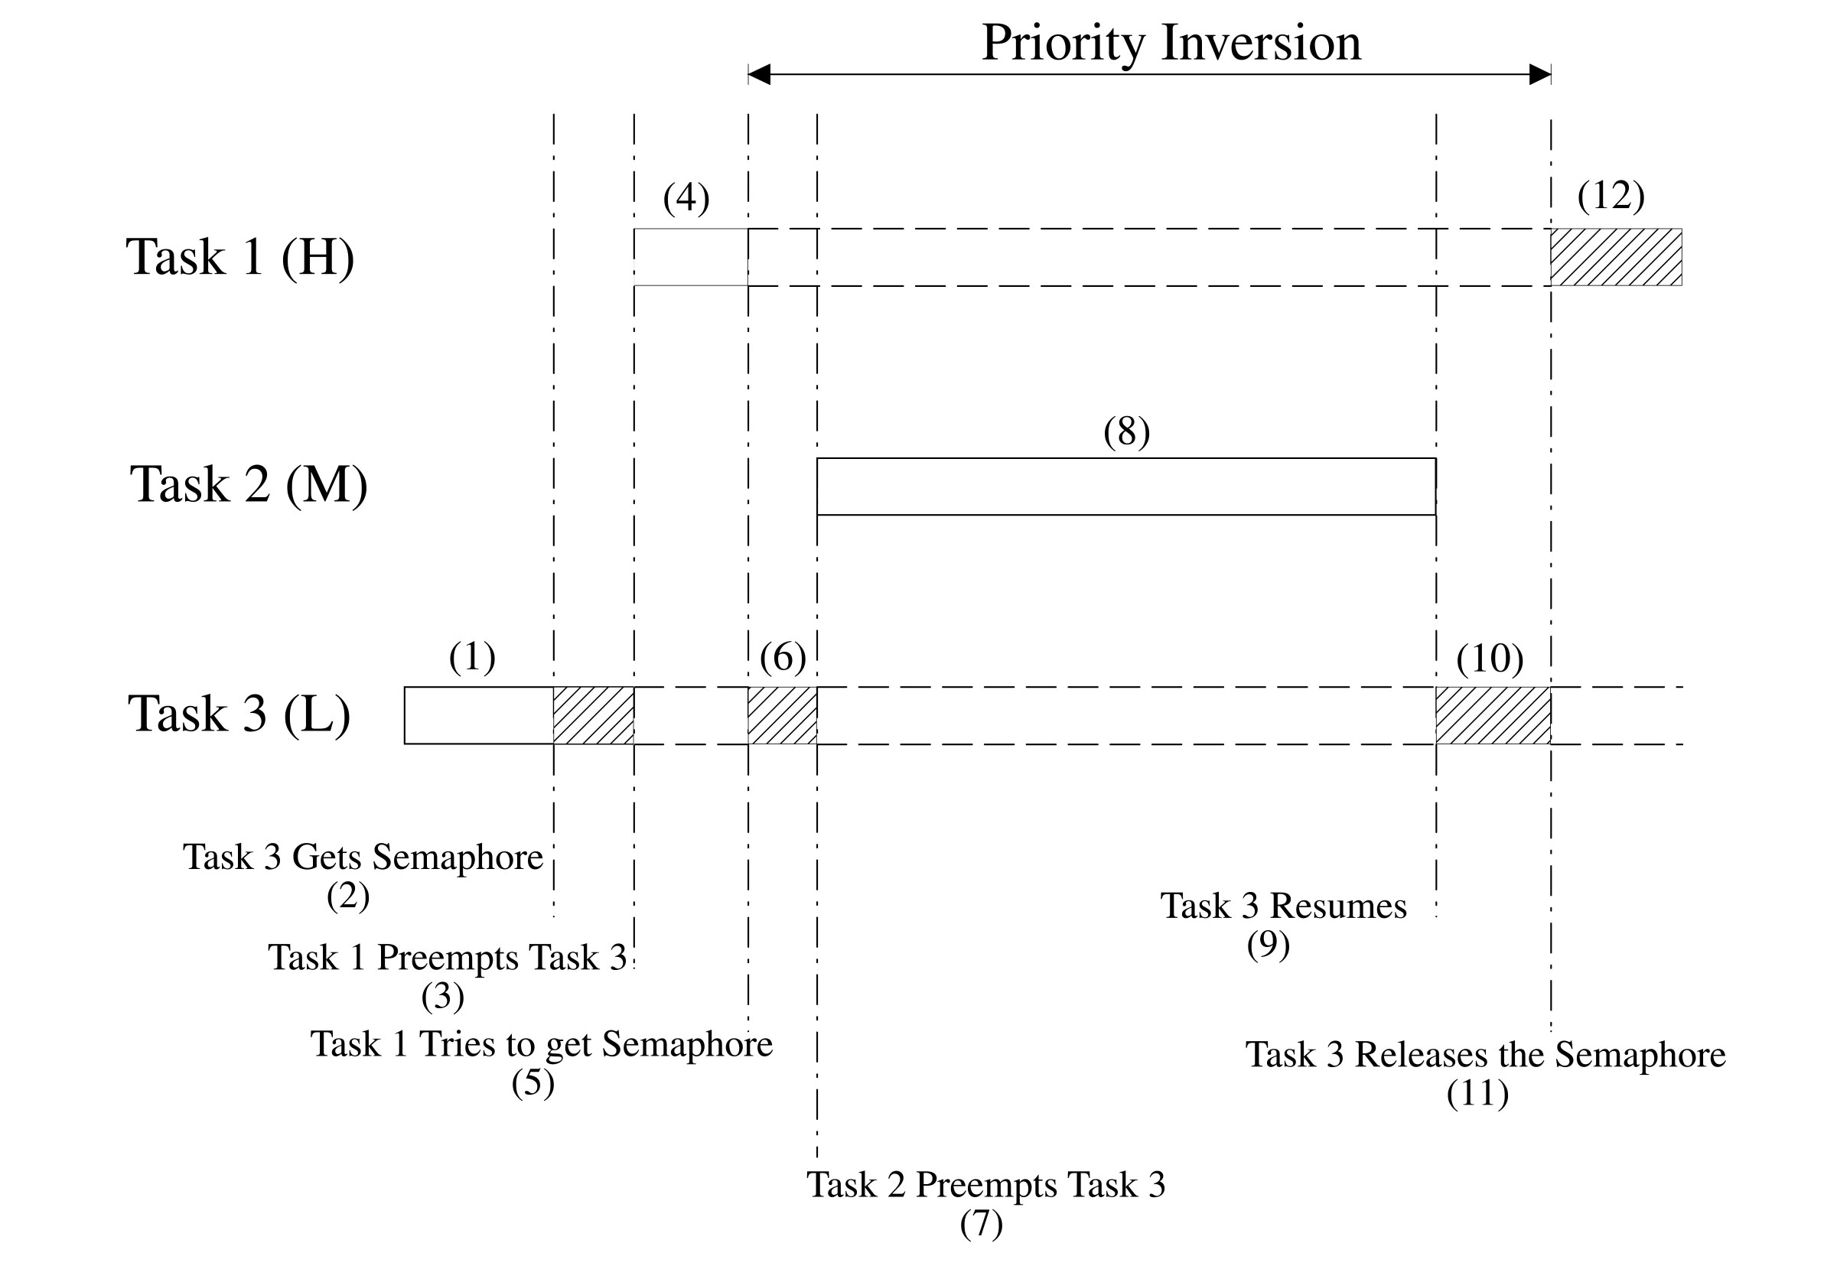
Priority Inversions

Slide 20
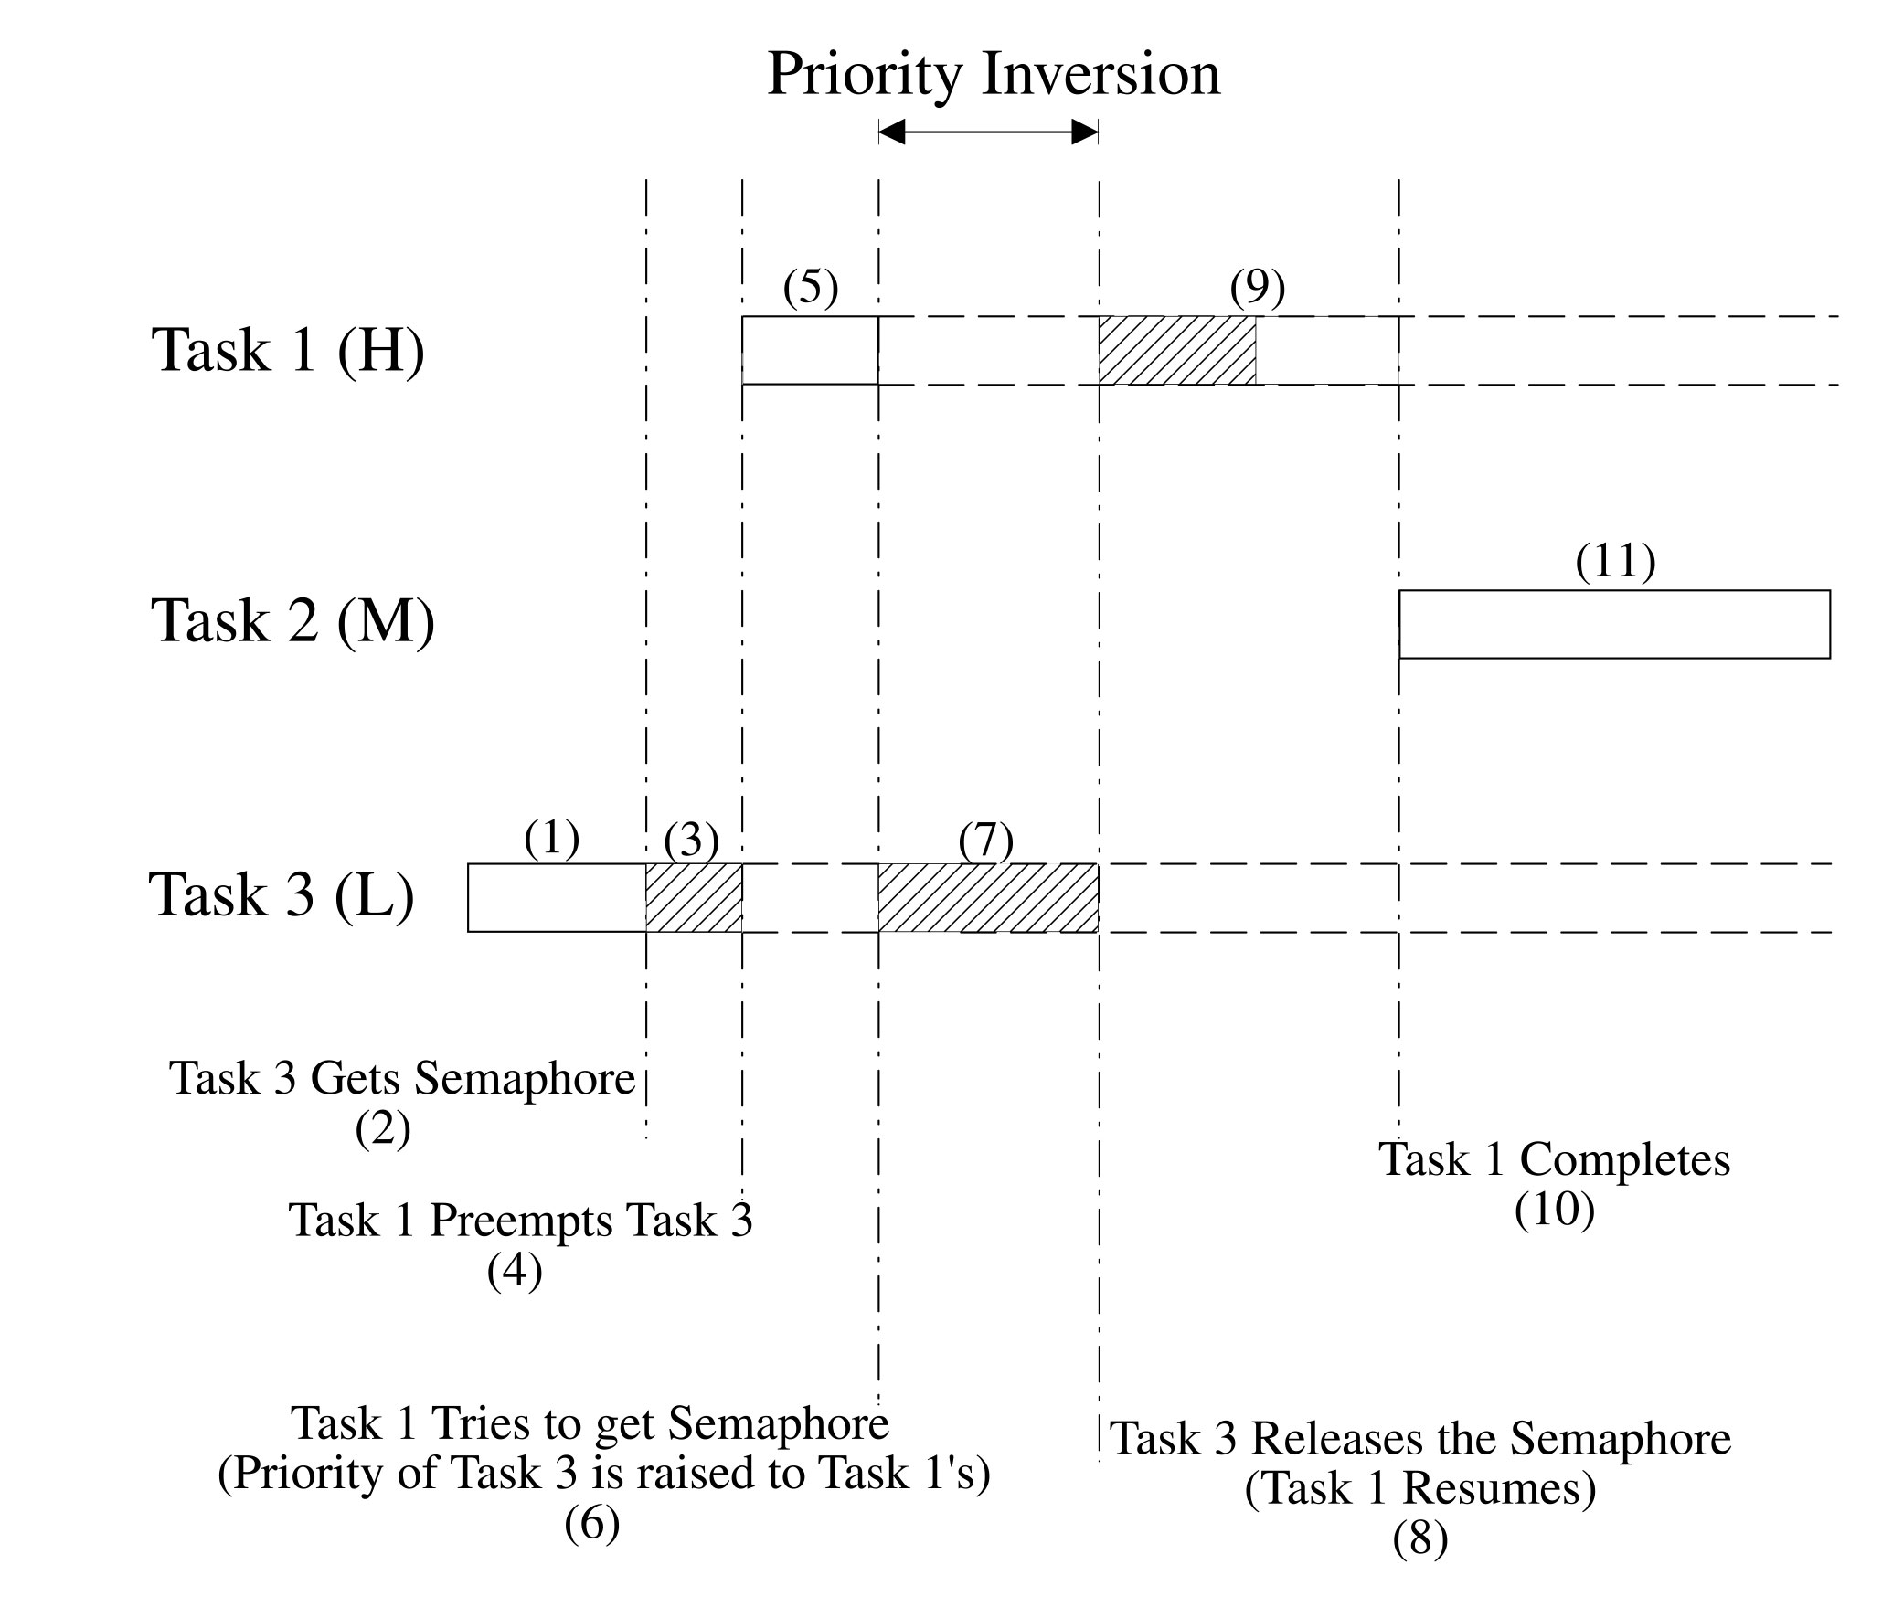
Priority Inversions

Slide 21
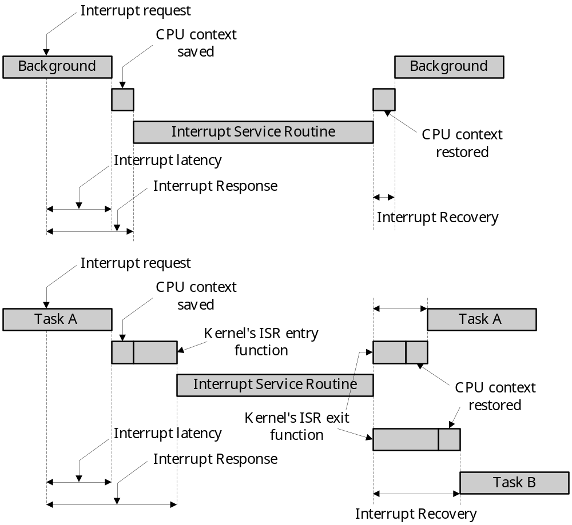
ISR processing time

Slide 22
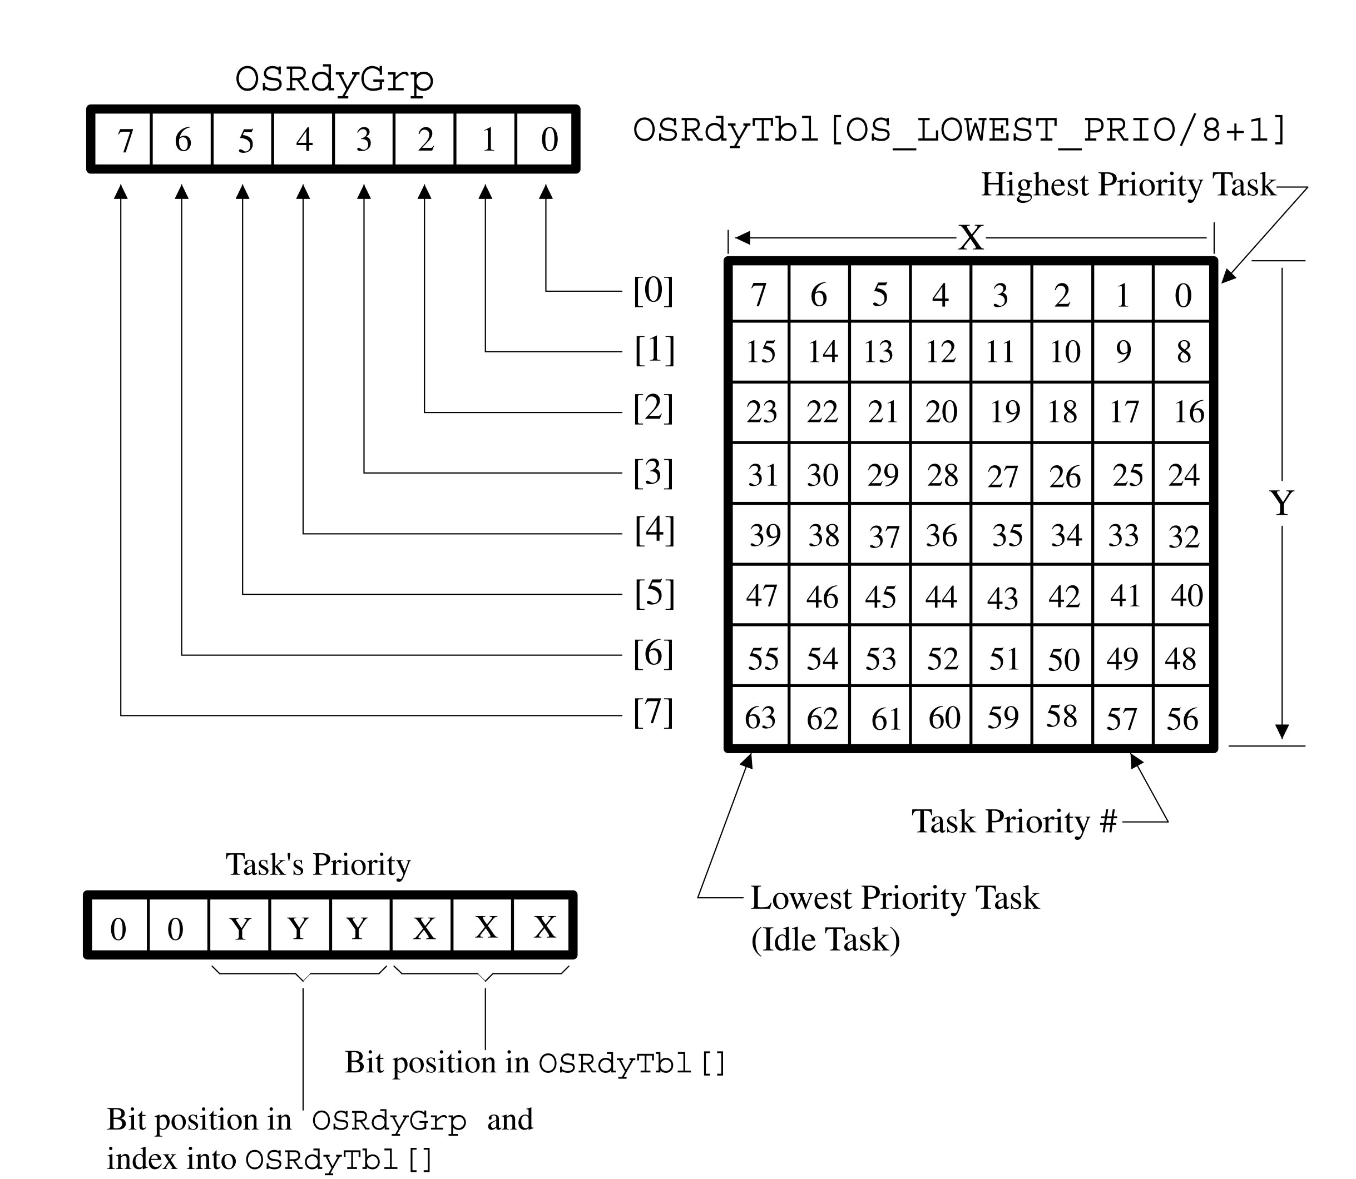
Ready List

Slide 23
Mapping Tables
INT8U const OSMapTbl[] = {0x01, 0x02, 0x04, 0x08, 0x10, 0x20, 0x40, 0x80};
INT8U const OSUnMapTbl[] = {
0, 0, 1, 0, 2, 0, 1, 0, 3, 0, 1, 0, 2, 0, 1, 0,
4, 0, 1, 0, 2, 0, 1, 0, 3, 0, 1, 0, 2, 0, 1, 0,
5, 0, 1, 0, 2, 0, 1, 0, 3, 0, 1, 0, 2, 0, 1, 0,
4, 0, 1, 0, 2, 0, 1, 0, 3, 0, 1, 0, 2, 0, 1, 0,
6, 0, 1, 0, 2, 0, 1, 0, 3, 0, 1, 0, 2, 0, 1, 0,
4, 0, 1, 0, 2, 0, 1, 0, 3, 0, 1, 0, 2, 0, 1, 0,
5, 0, 1, 0, 2, 0, 1, 0, 3, 0, 1, 0, 2, 0, 1, 0,
4, 0, 1, 0, 2, 0, 1, 0, 3, 0, 1, 0, 2, 0, 1, 0,
7, 0, 1, 0, 2, 0, 1, 0, 3, 0, 1, 0, 2, 0, 1, 0,
4, 0, 1, 0, 2, 0, 1, 0, 3, 0, 1, 0, 2, 0, 1, 0,
5, 0, 1, 0, 2, 0, 1, 0, 3, 0, 1, 0, 2, 0, 1, 0,
4, 0, 1, 0, 2, 0, 1, 0, 3, 0, 1, 0, 2, 0, 1, 0,
6, 0, 1, 0, 2, 0, 1, 0, 3, 0, 1, 0, 2, 0, 1, 0,
4, 0, 1, 0, 2, 0, 1, 0, 3, 0, 1, 0, 2, 0, 1, 0,
5, 0, 1, 0, 2, 0, 1, 0, 3, 0, 1, 0, 2, 0, 1, 0,
4, 0, 1, 0, 2, 0, 1, 0, 3, 0, 1, 0, 2, 0, 1, 0
};

Slide 24
Ready List Handling
Ready list
  OSRdyGrp, OSRdyTbl[]
  Making a task ready to run
  Removing a task from the ready list
  Finding the highest priority task ready to run
OSRdyGrp |= OSMapTbl[prio >> 3];
OSRdyTbl[prio >> 3] |= OSMapTbl[prio & 0x07];
if((OSRdyTbl[prio>>3] &= ~OSMapTbl[prio & 0x07]) == 0)
OSRdyGrp &= ~OSMapTbl[prio >> 3];
y = OSUnMapTbl[OSRdyGrp];
x = OSUnMapTbl[OSRdyTbl[y]];
prio = (y<<3) + x;

Slide 25
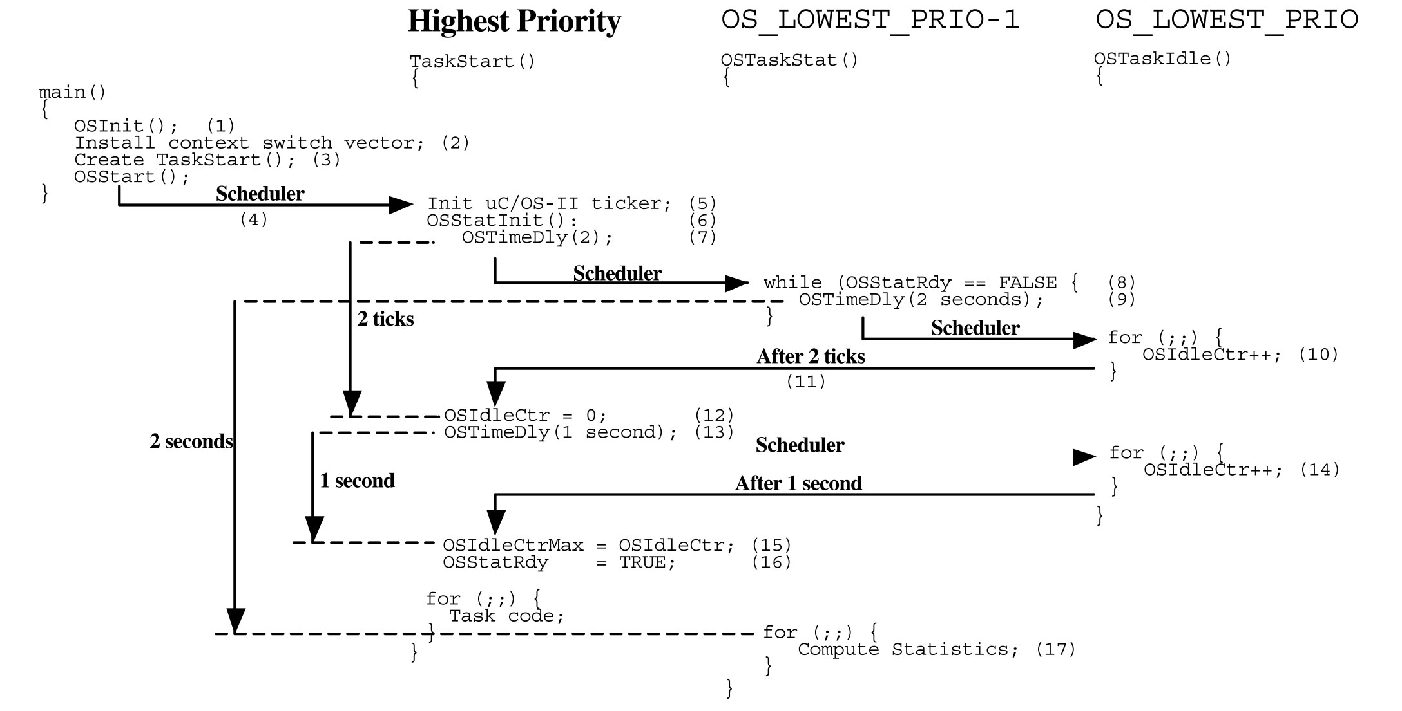
Initializing Statistics Task

Slide 26
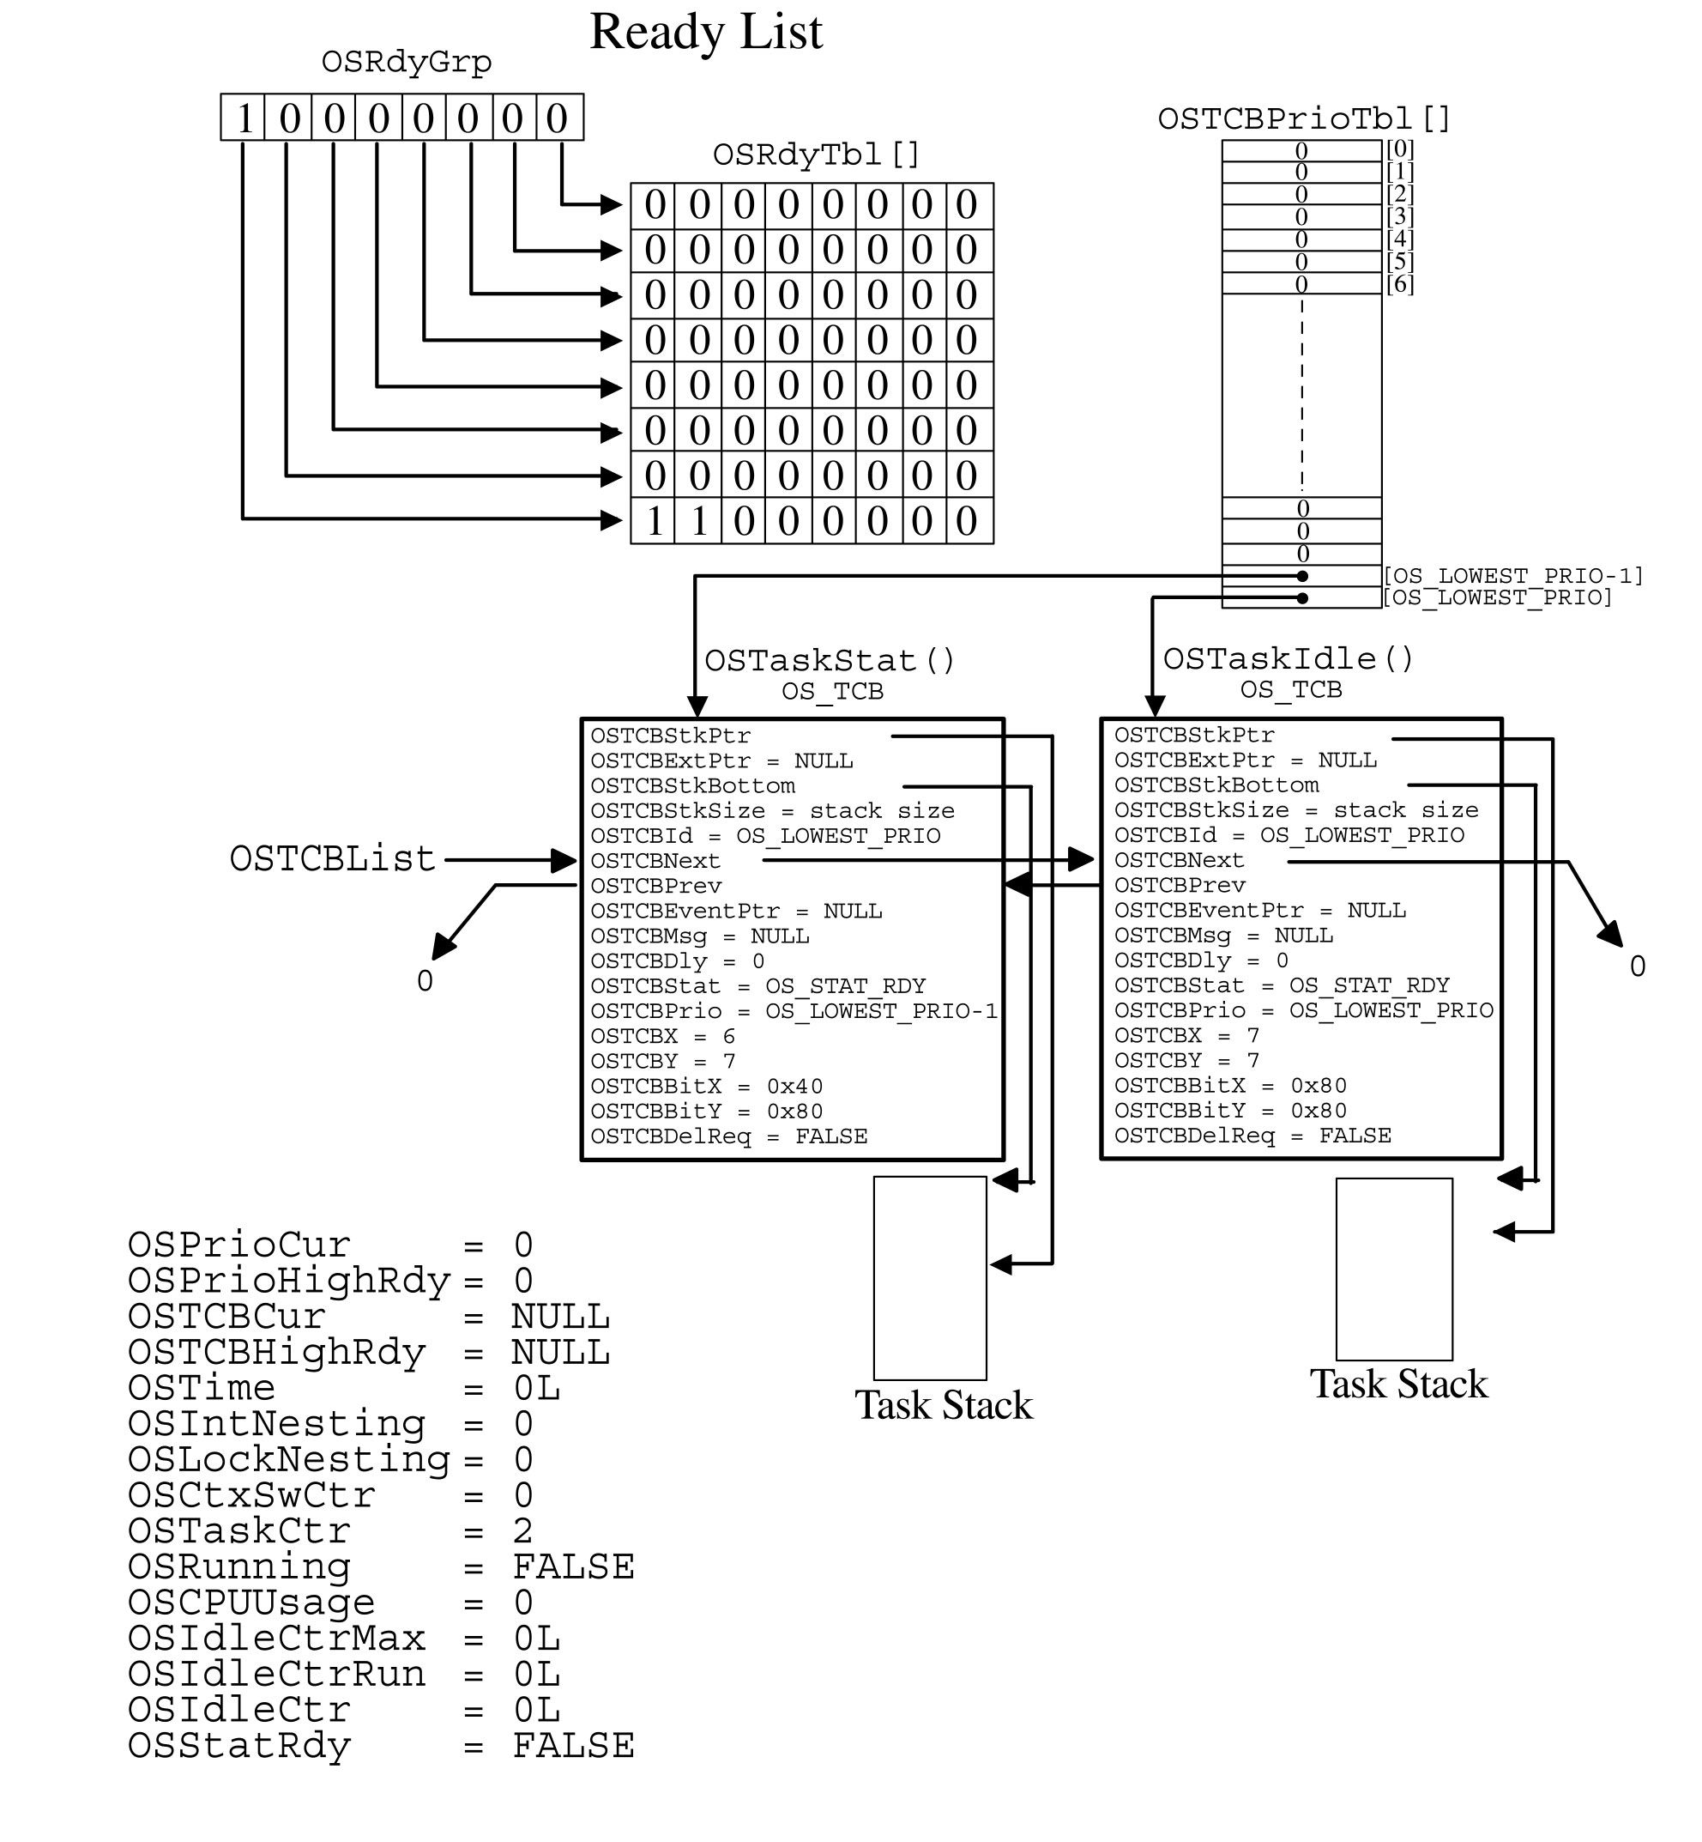
Data structure after OSInit()

Slide 27
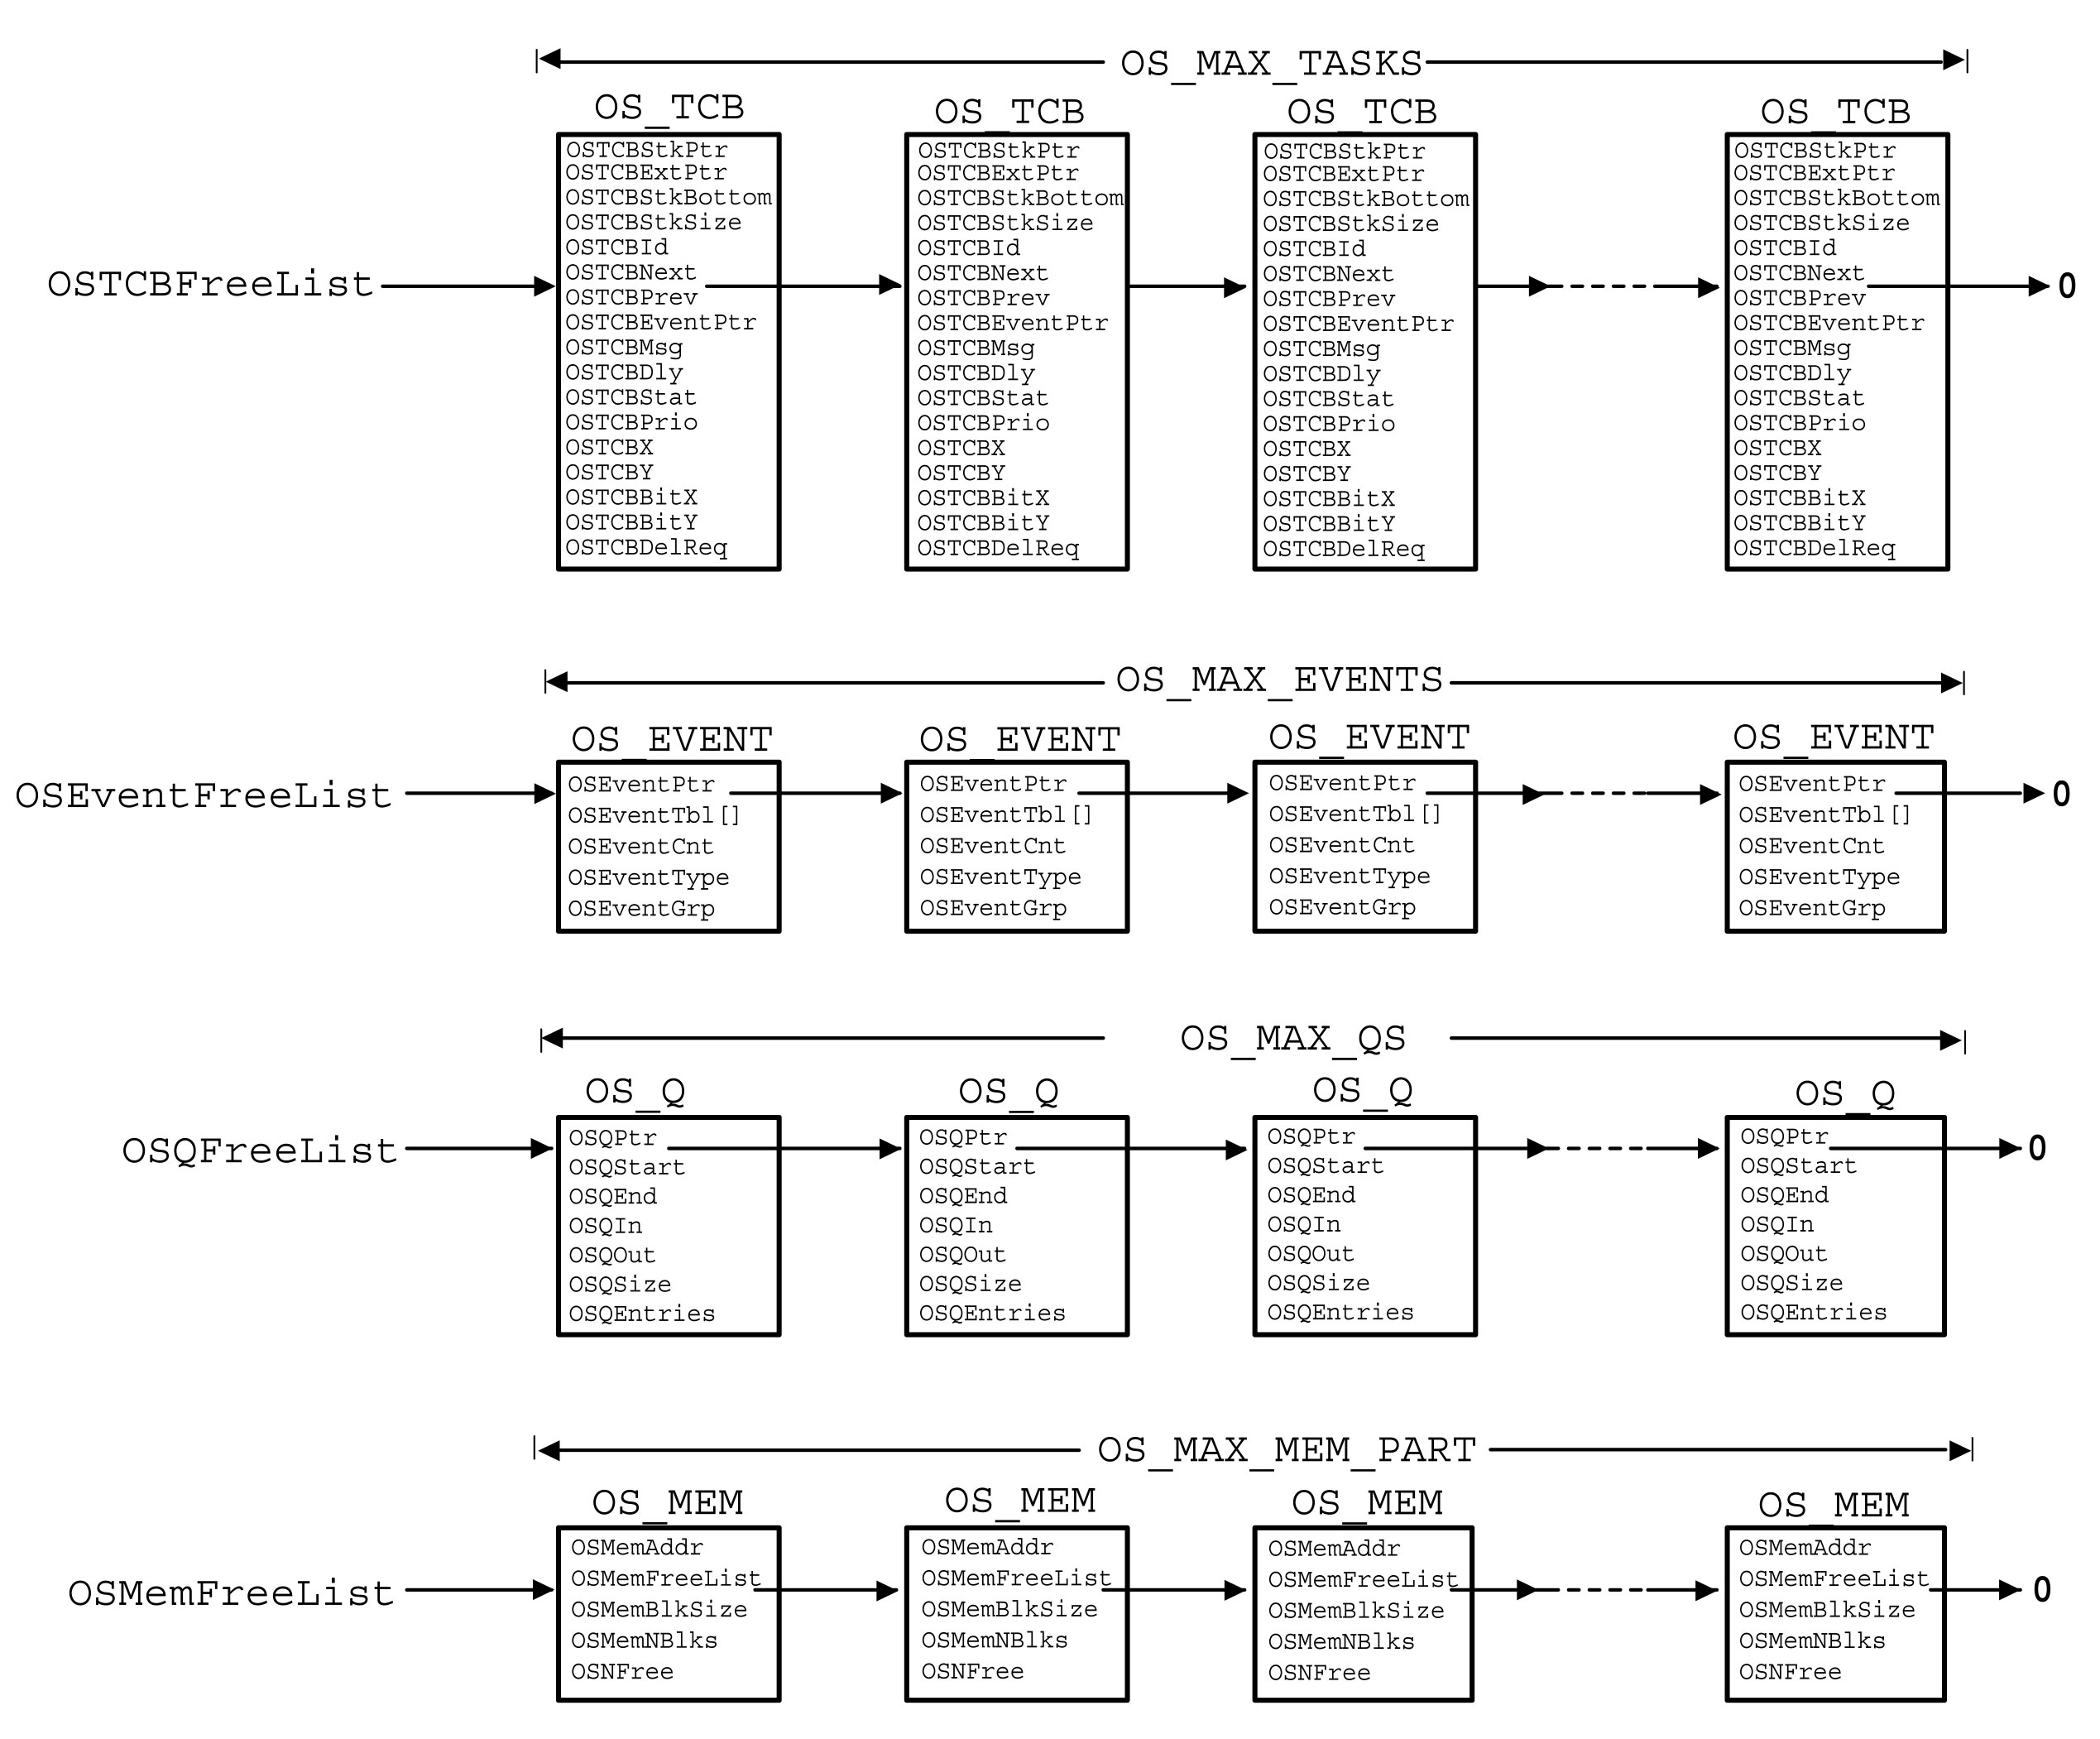
Free Pools

Slide 28
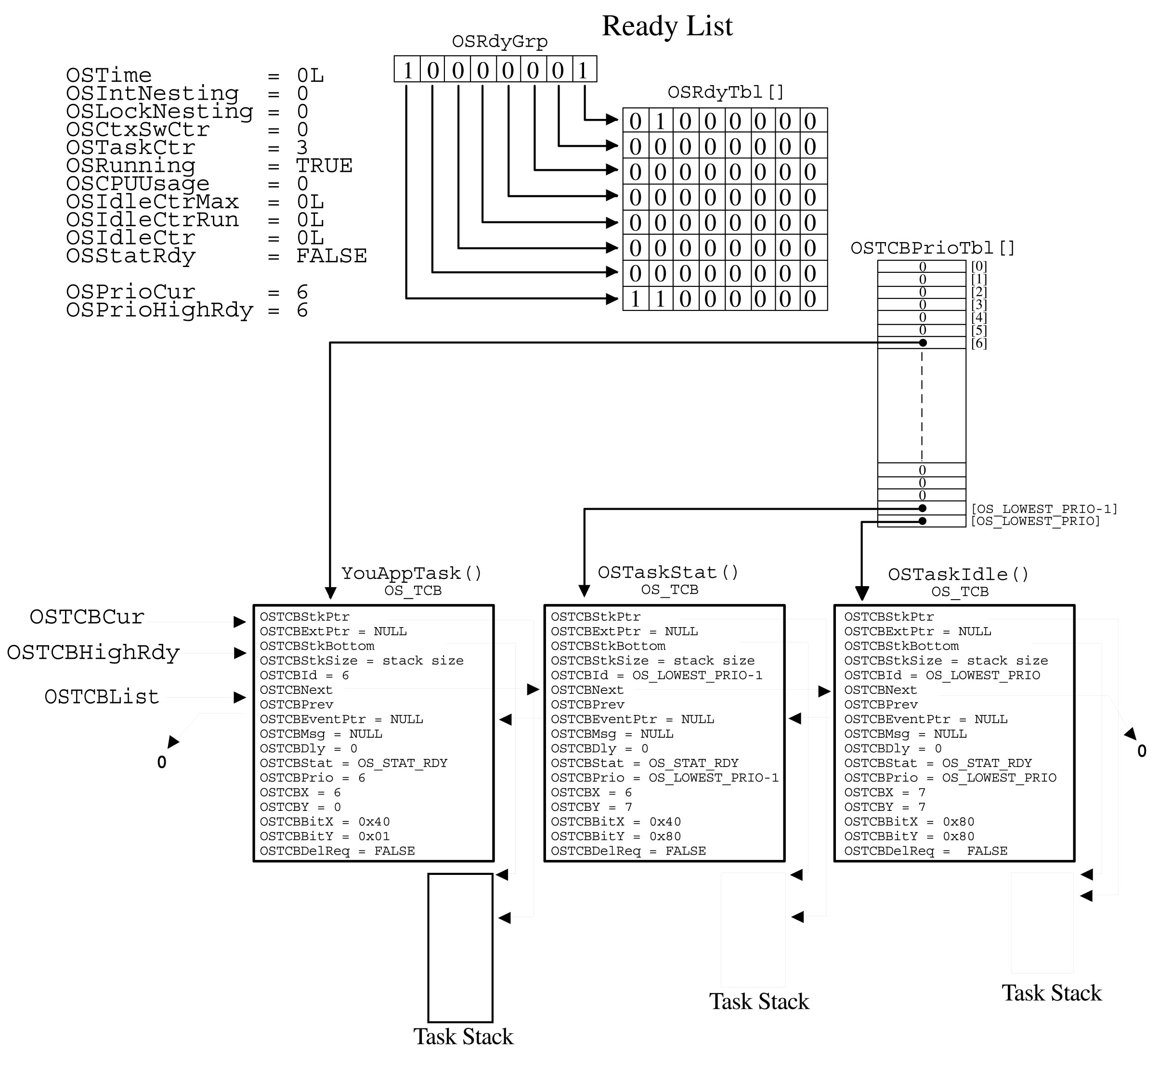
Data structure after OSStart()

Slide 29
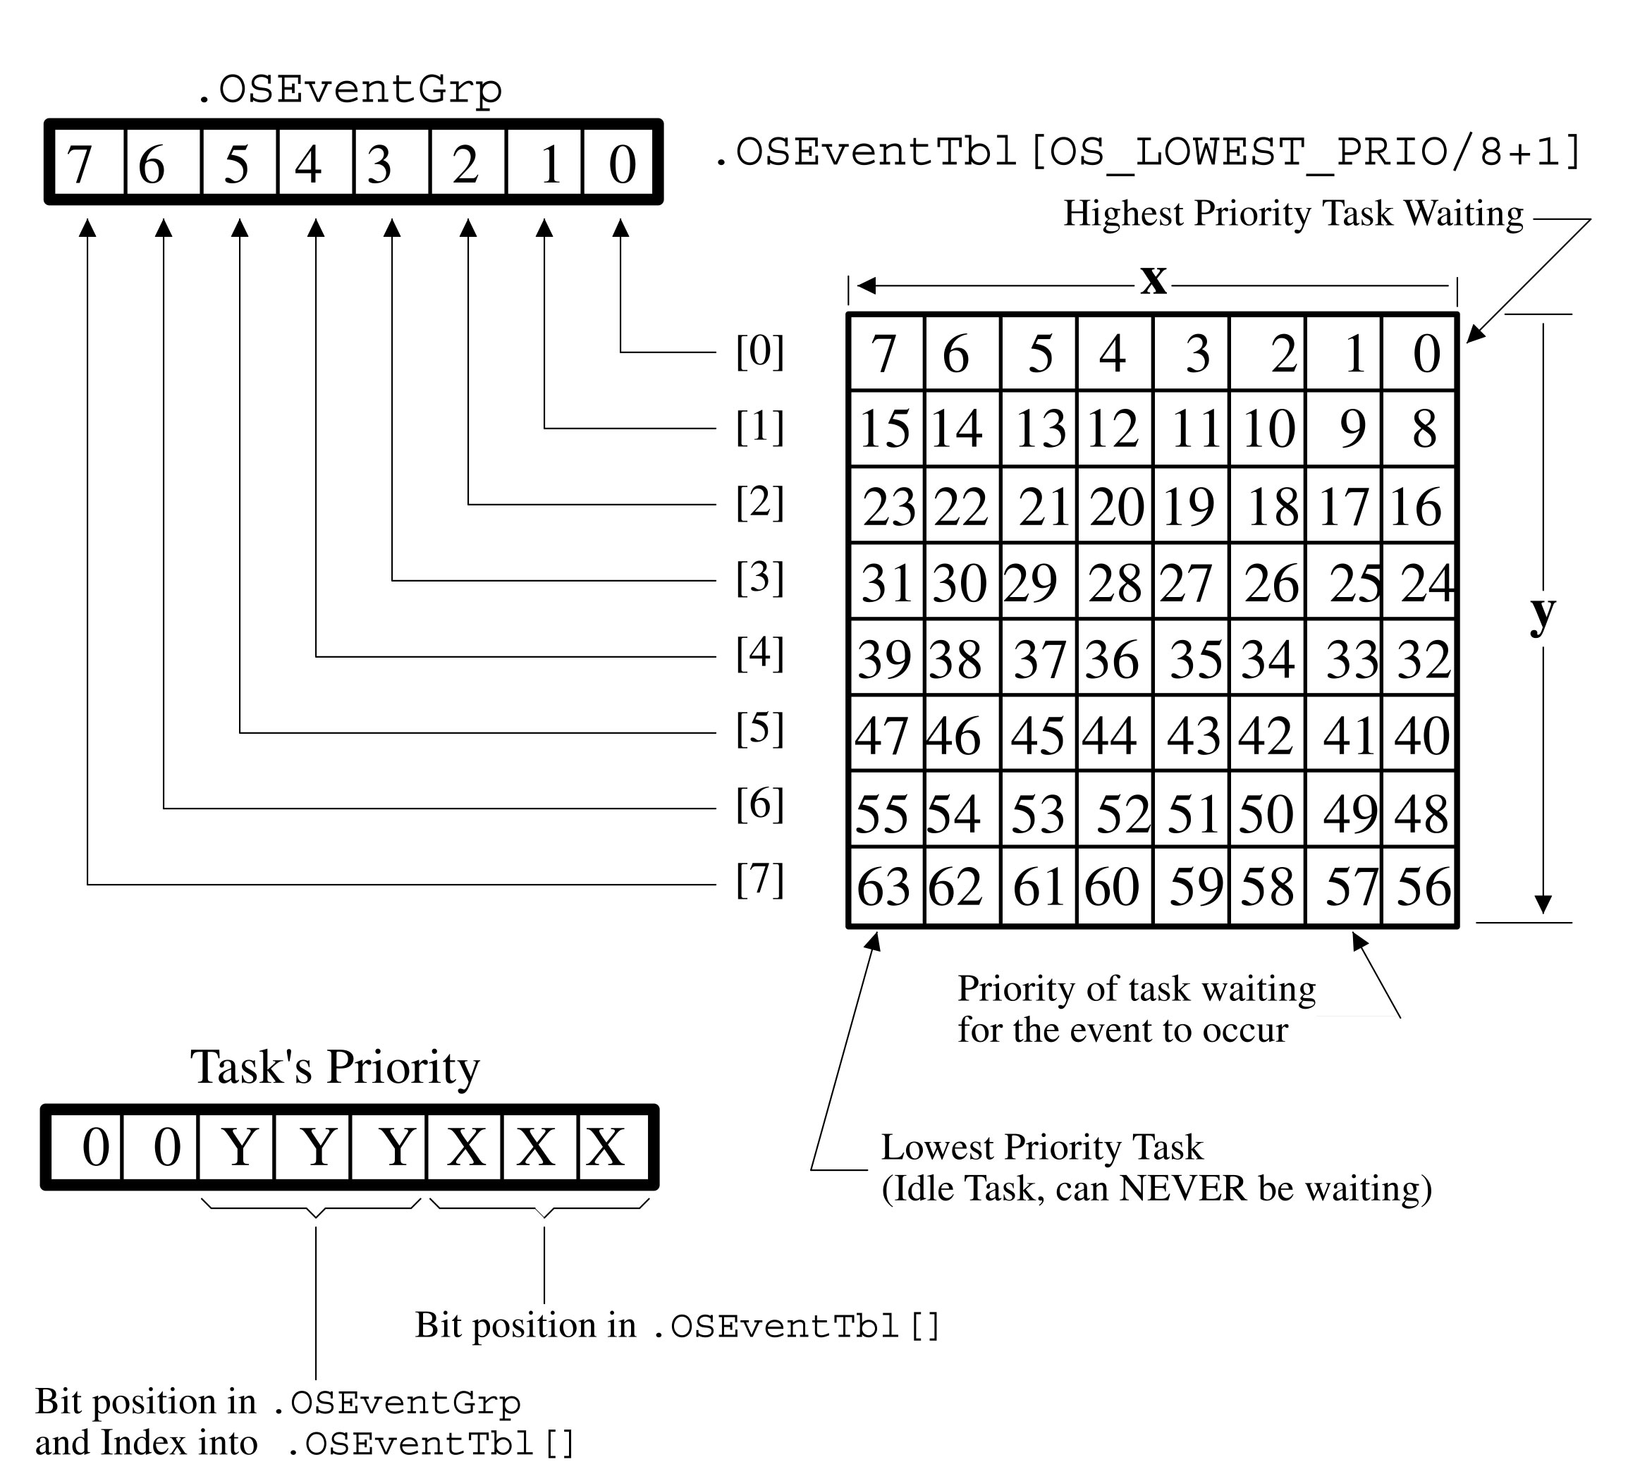
Event Wait List

Slide 30
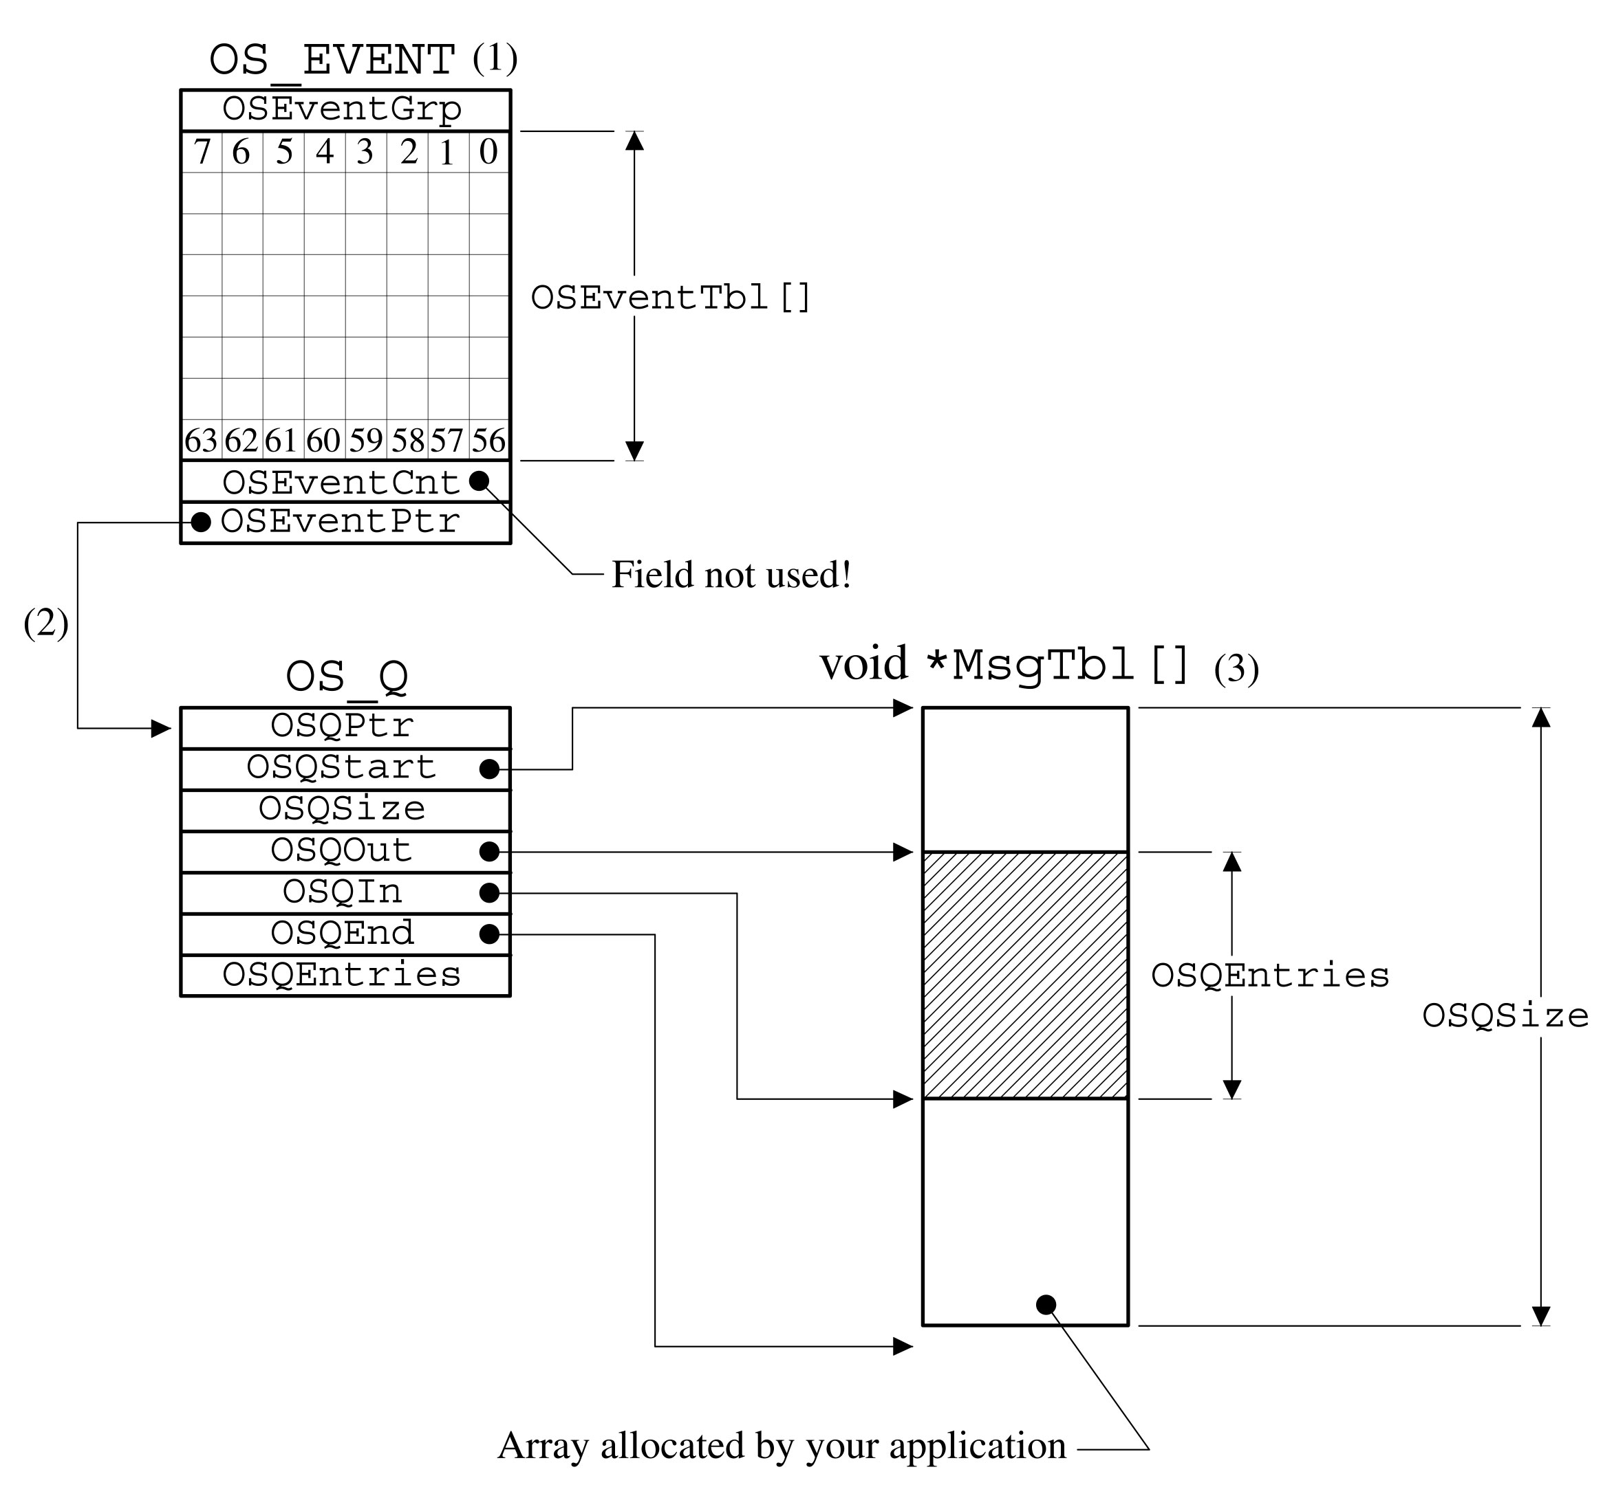
Message Queue Structure

Slide 31
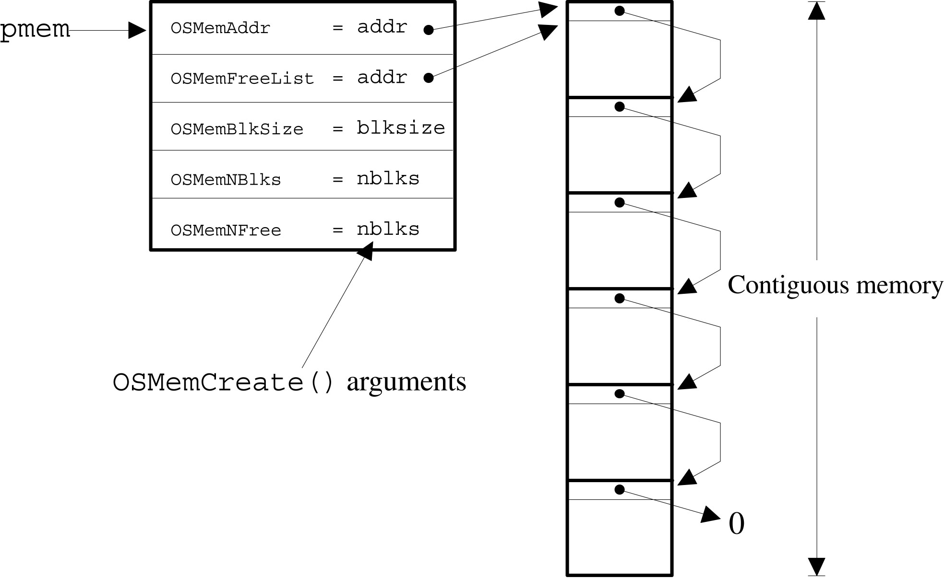
OSMemCreate()

Slide 32
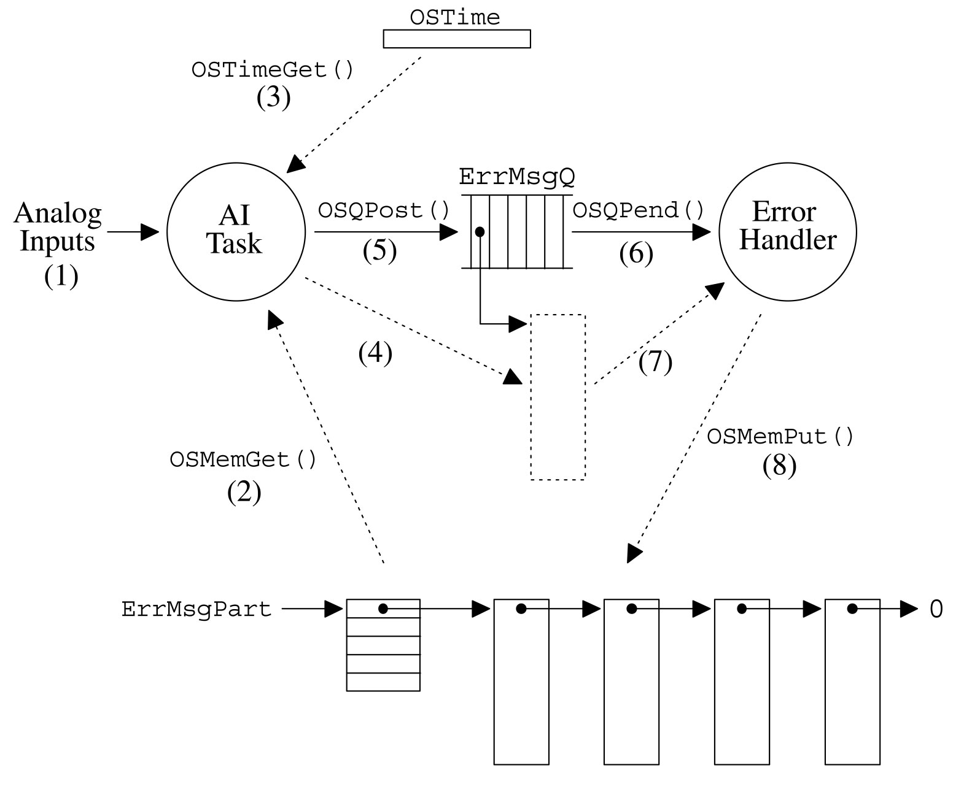
Dynamic Memory Allocation Example

Slide 33
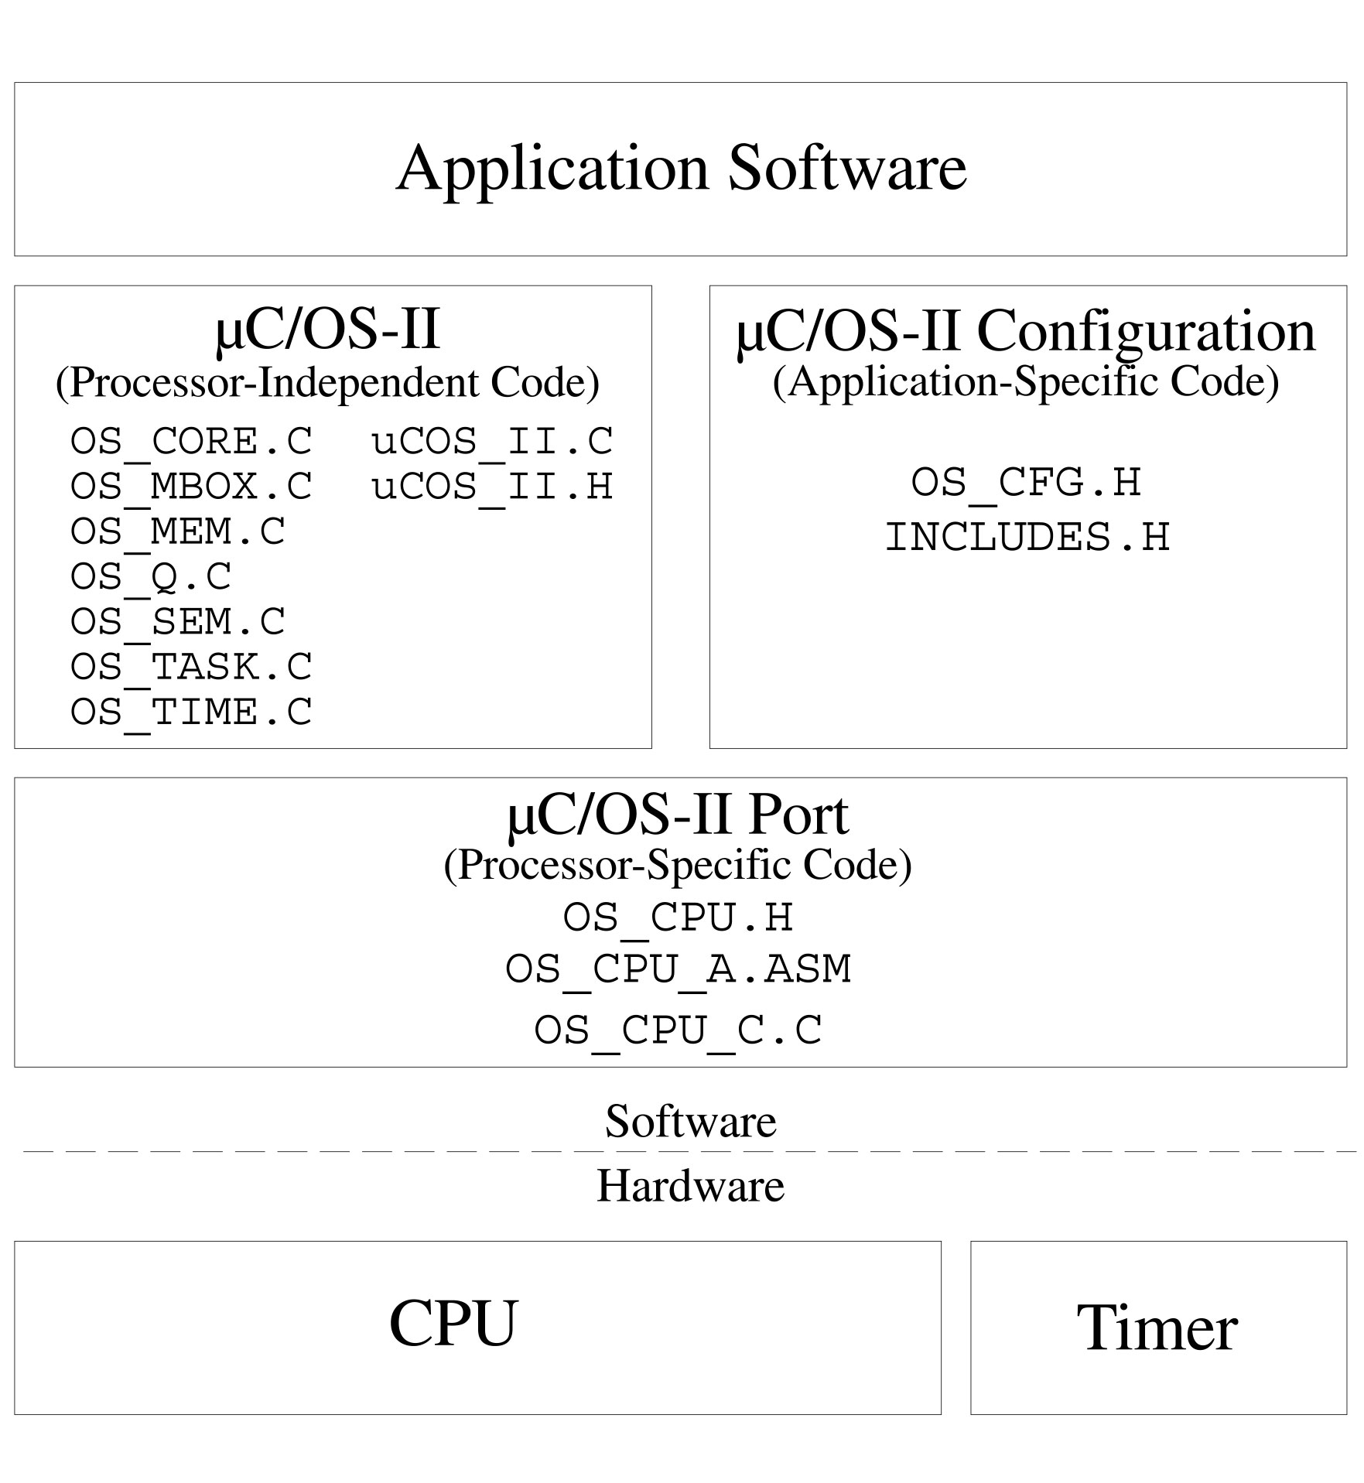
Porting MicroC/OS-II

Slide 34
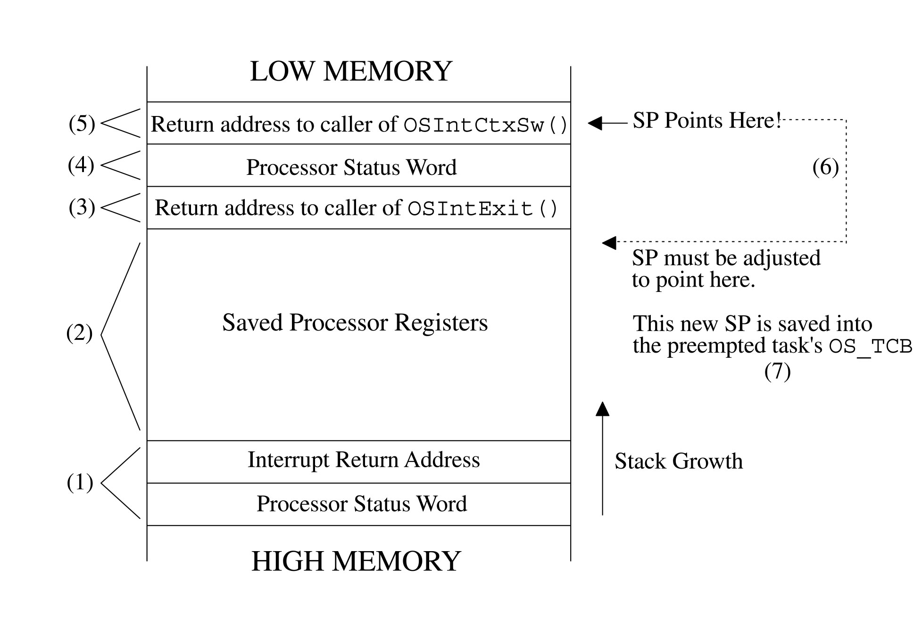
Stack Frame in ISR

Slide 35
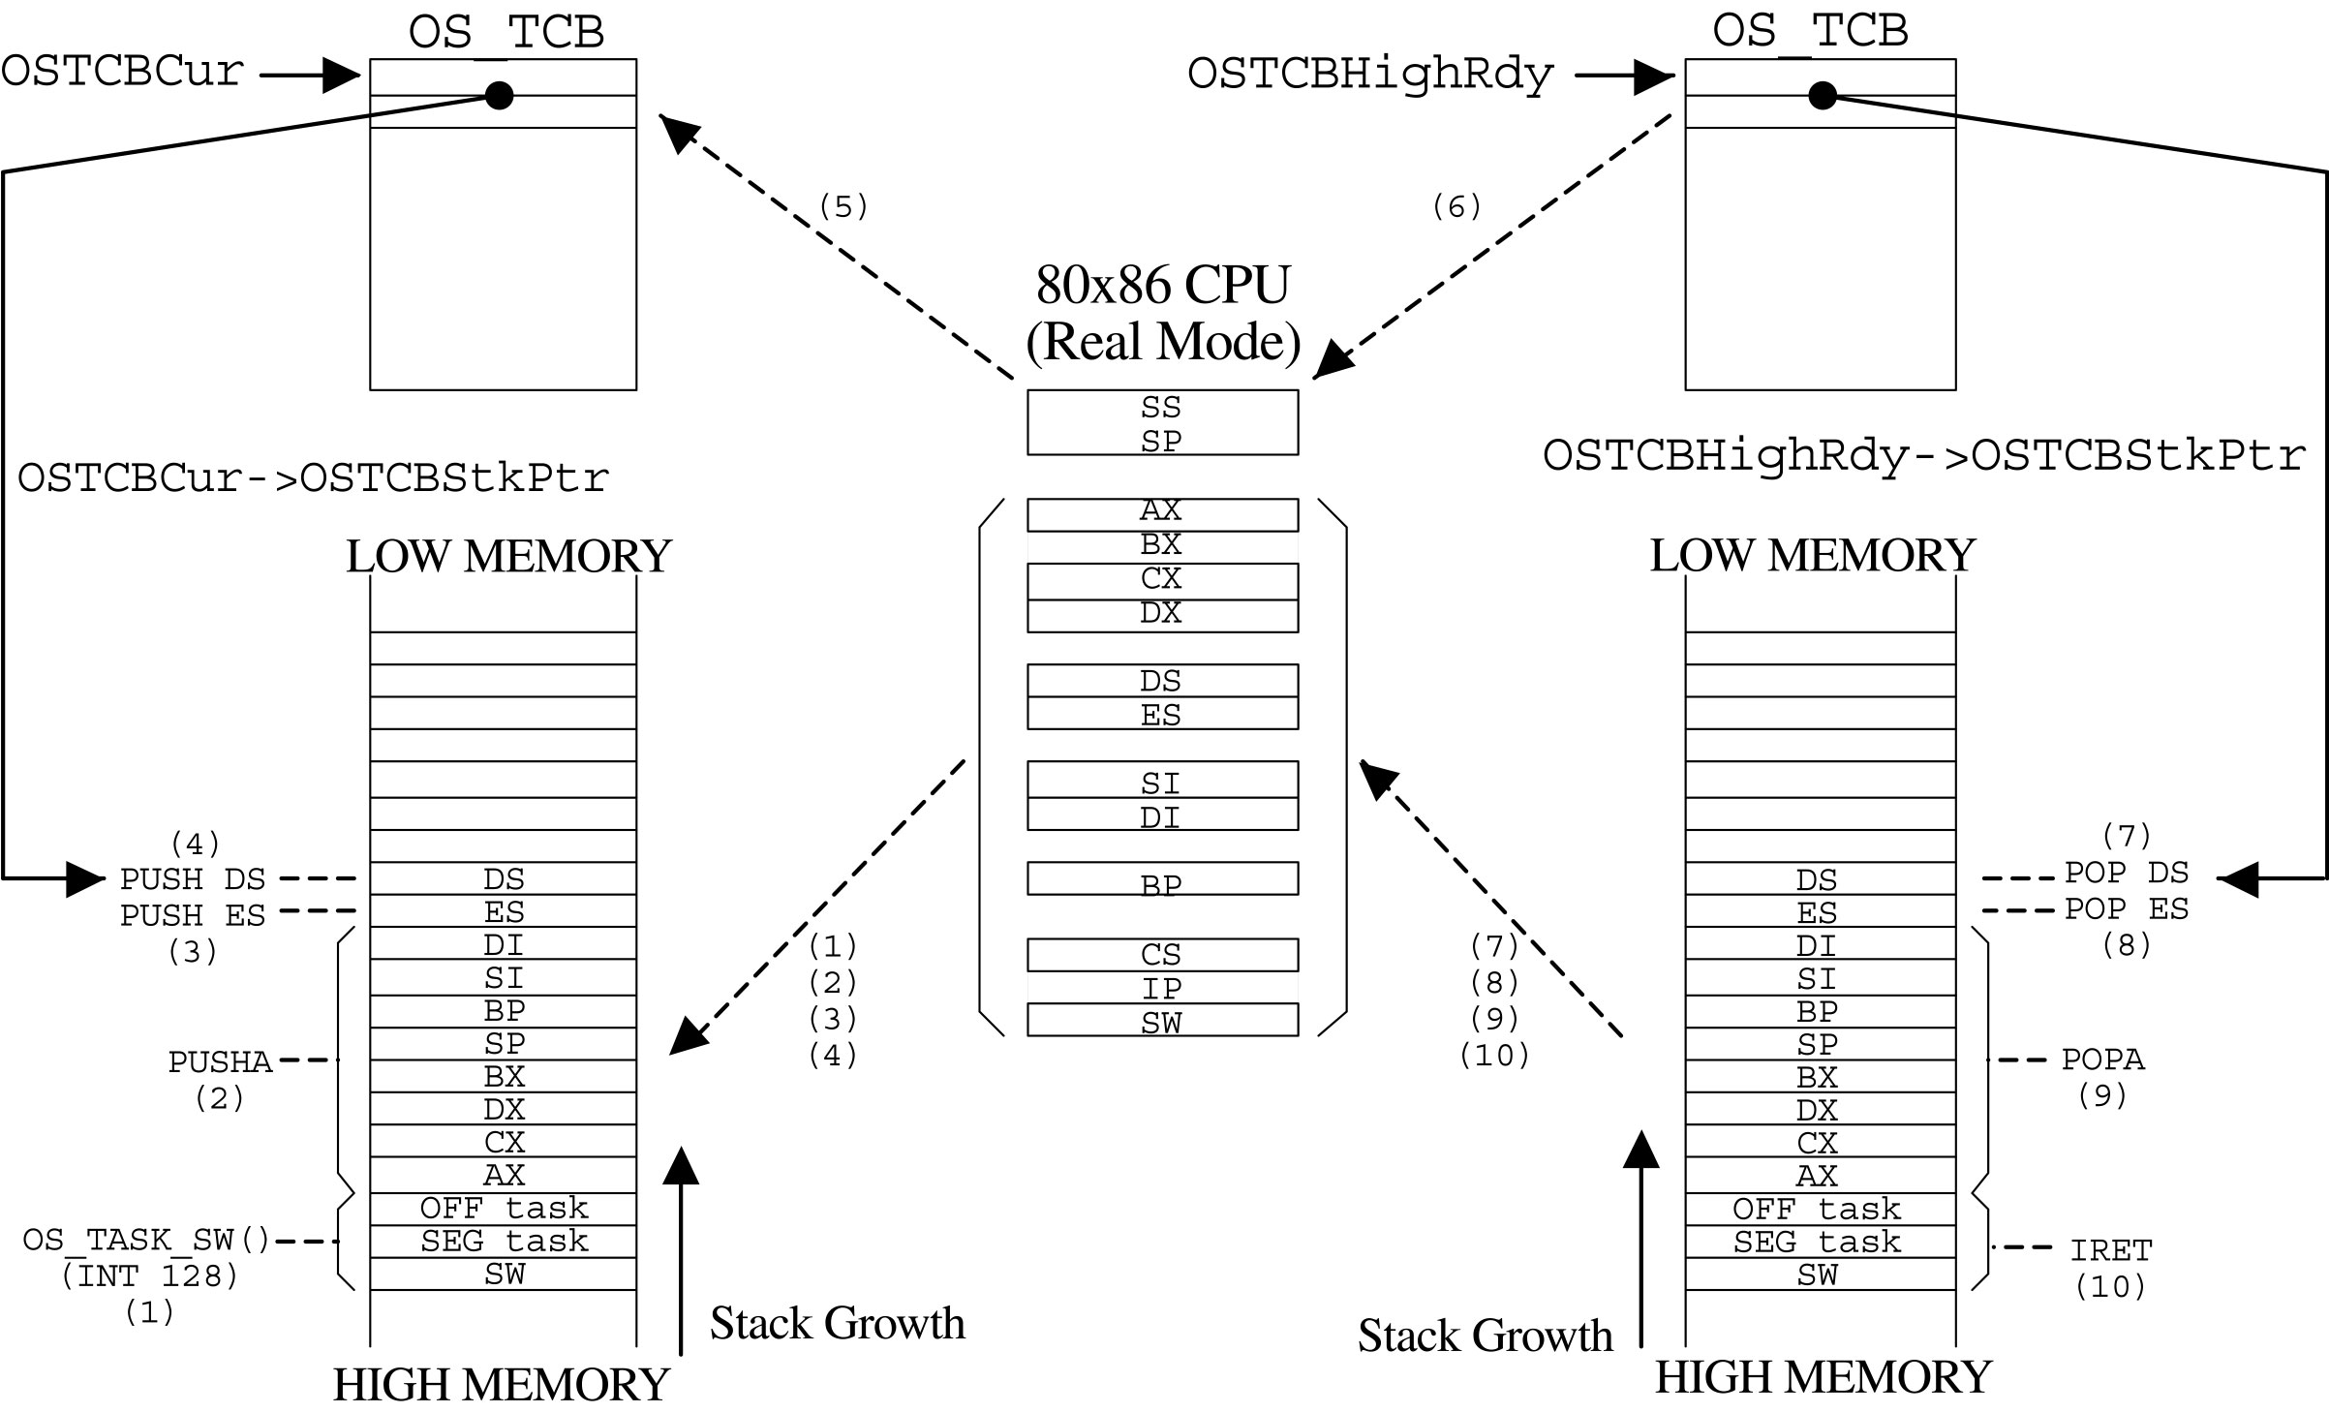
Task level context switch

Slide 36
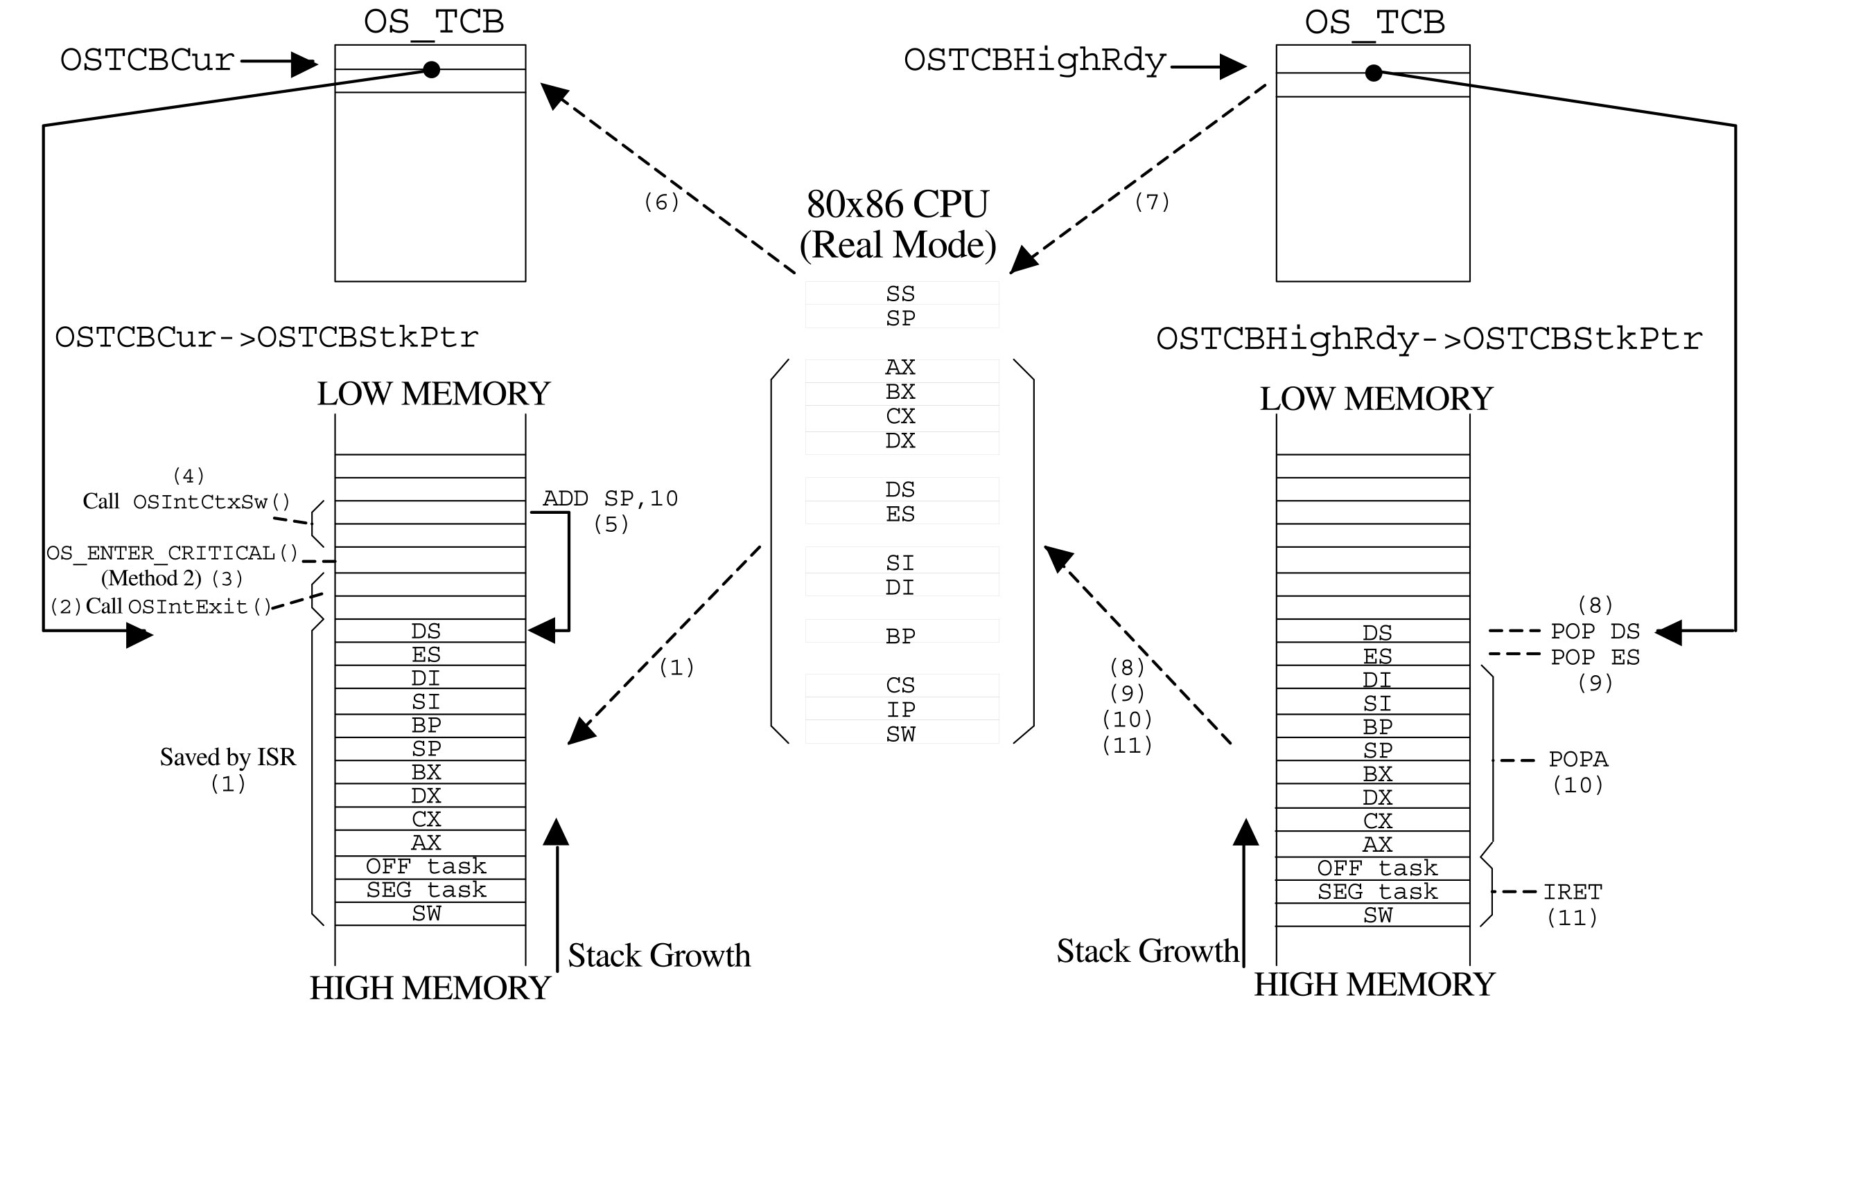
Interrupt level context switch

